Slide 1
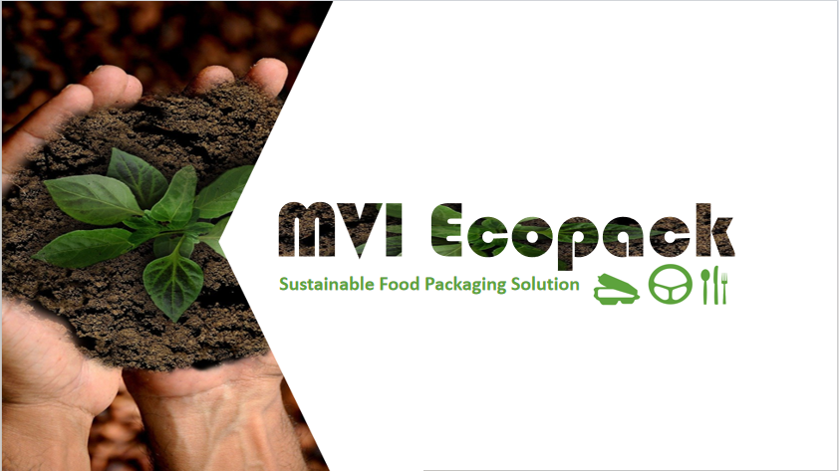
www.mviecopack.com

Slide 2
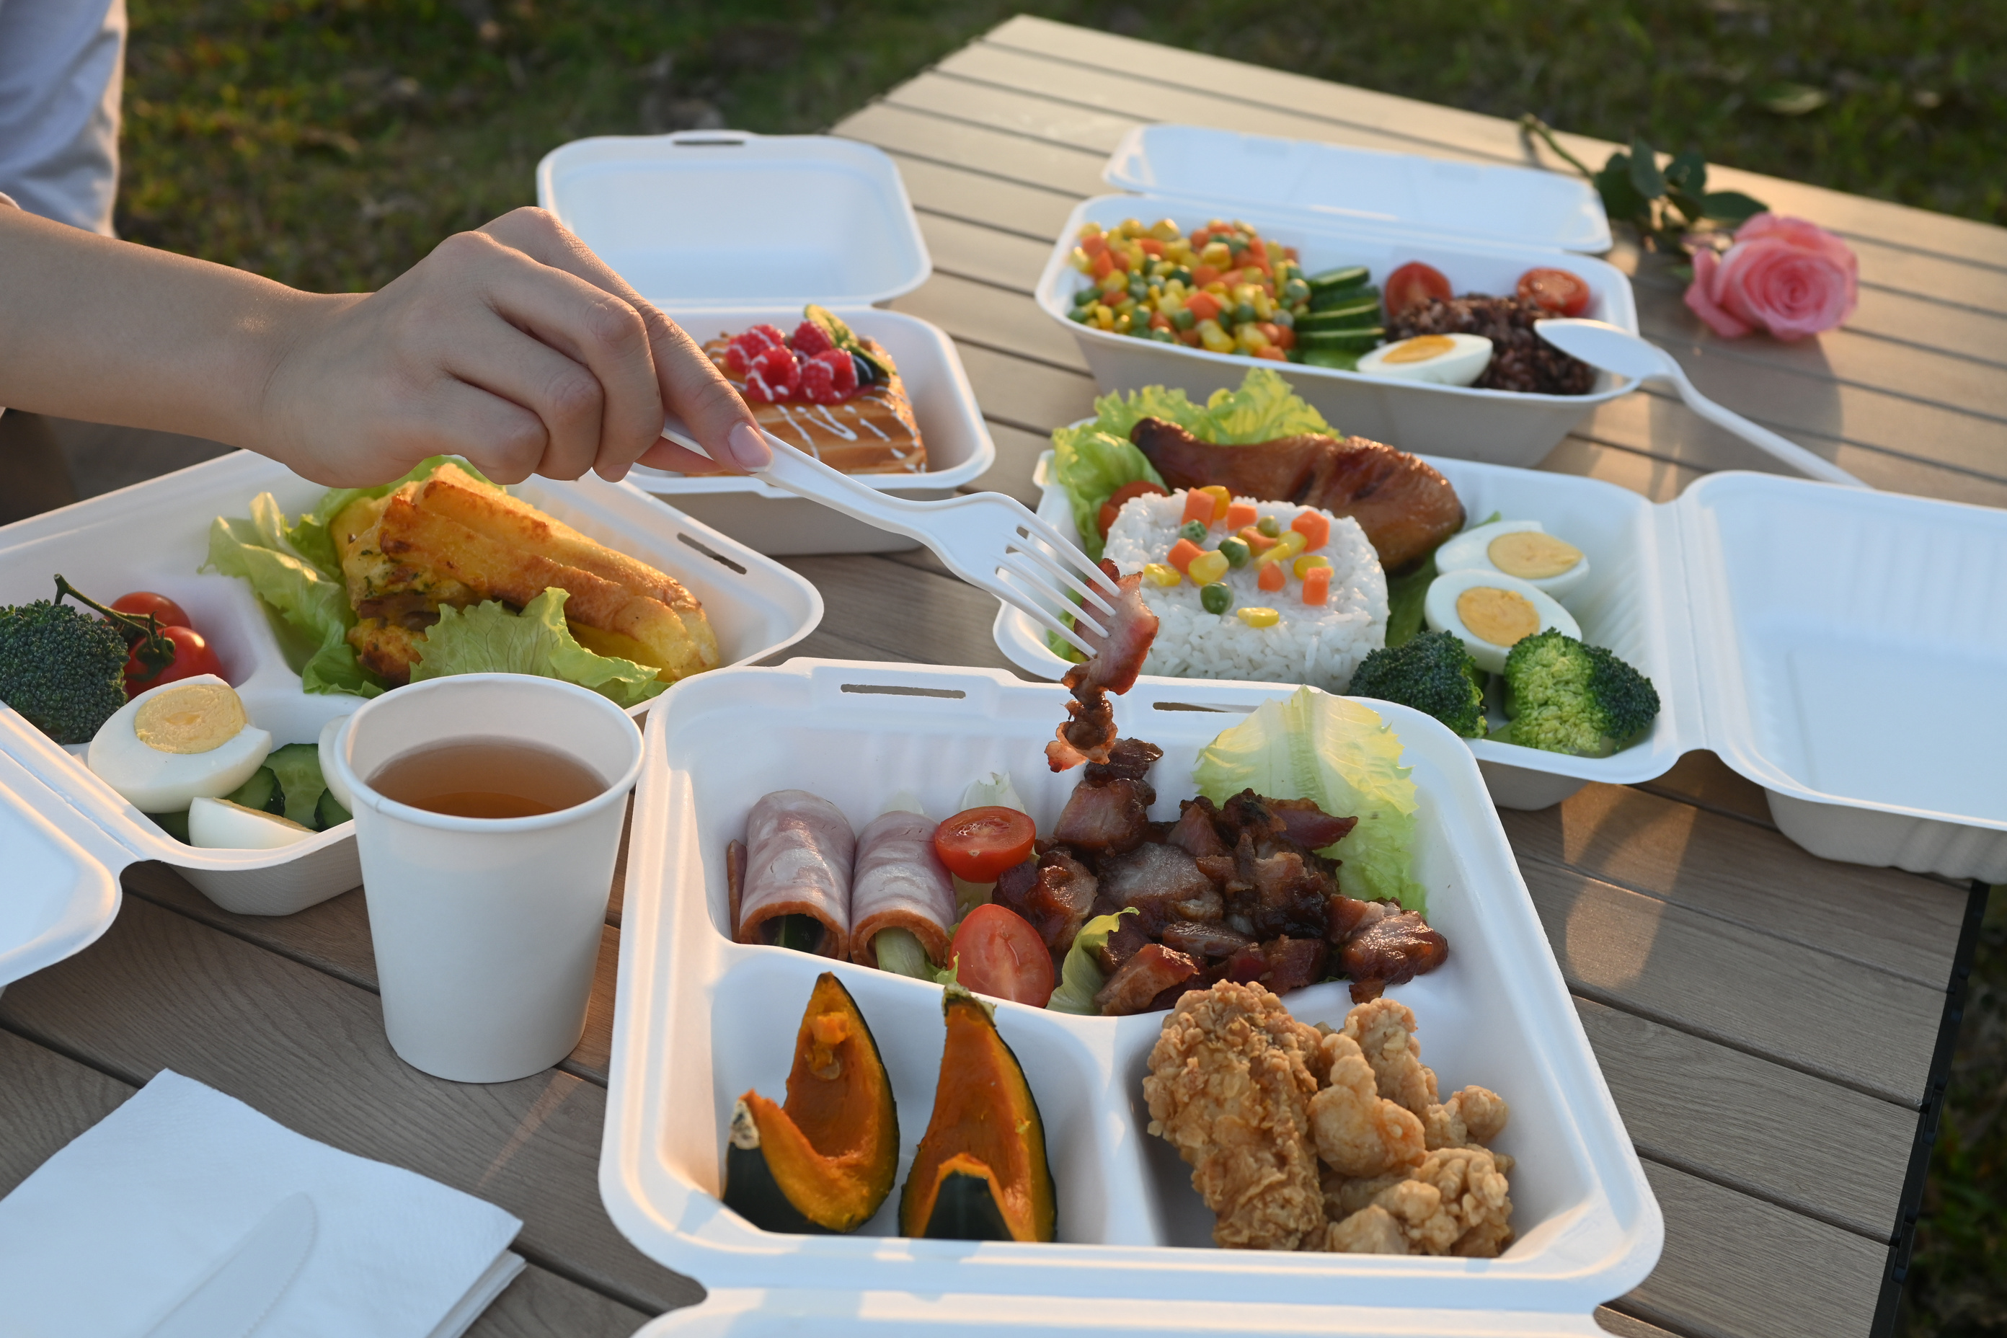

About us
Exhibitions
Sugarcane pulp Tableware
Cornstarch Tableware
CONTENTS
Recyclable paper cups
PET Cup Product
Aqueous Coating Paper Straw
Others
Contact Us
www.mviecopack.com

Slide 3
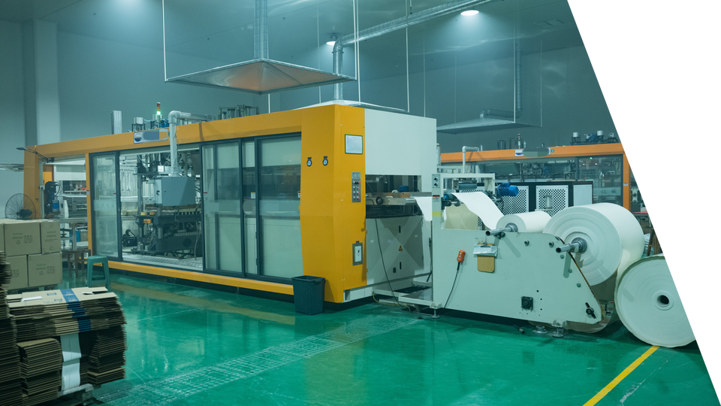
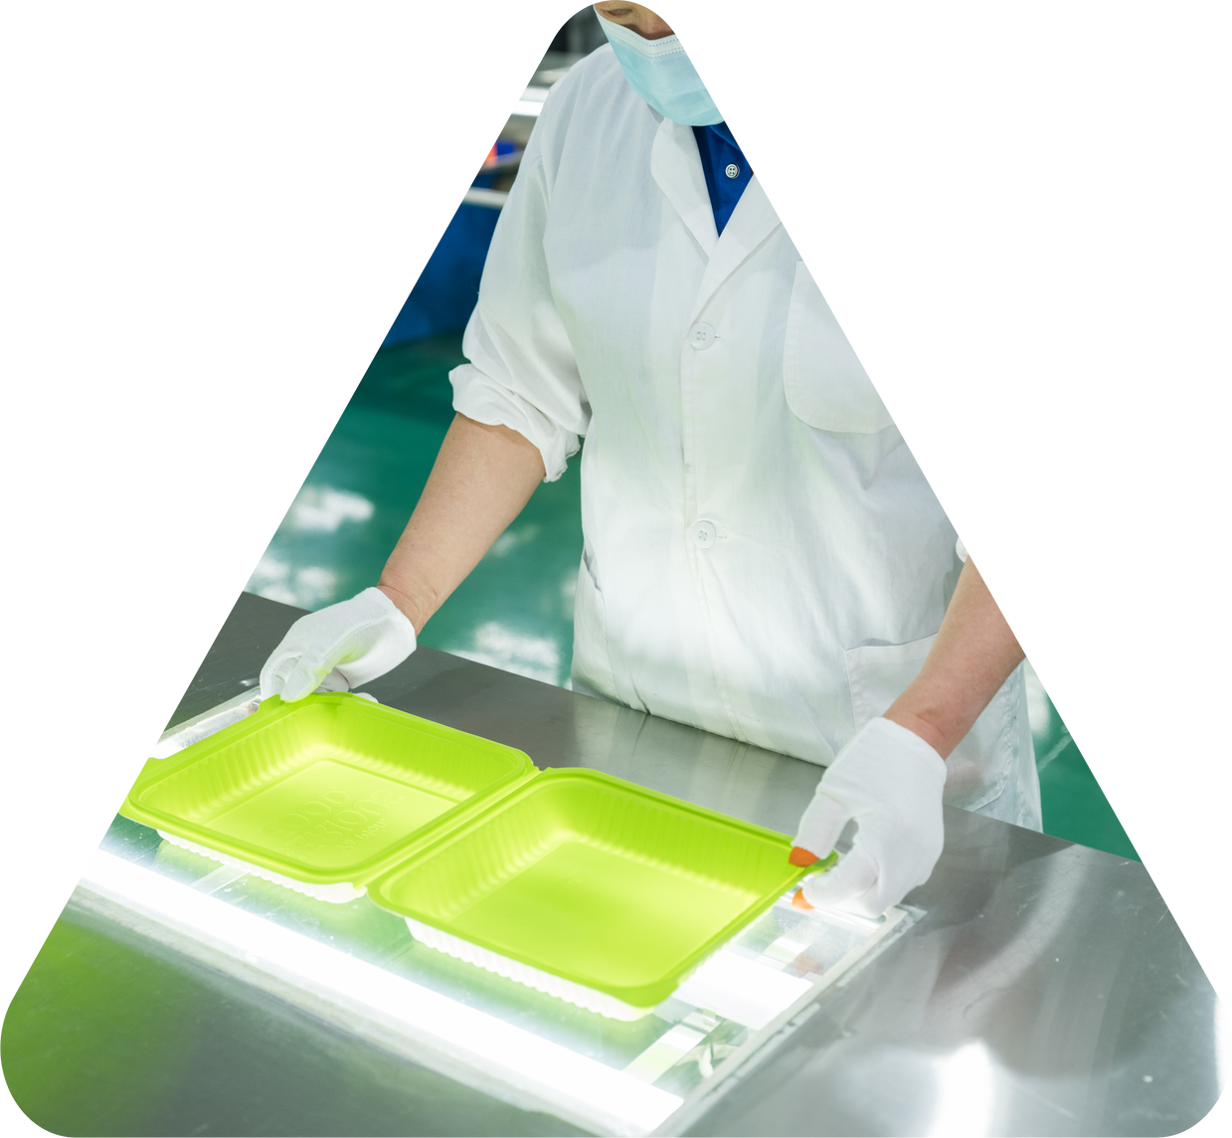
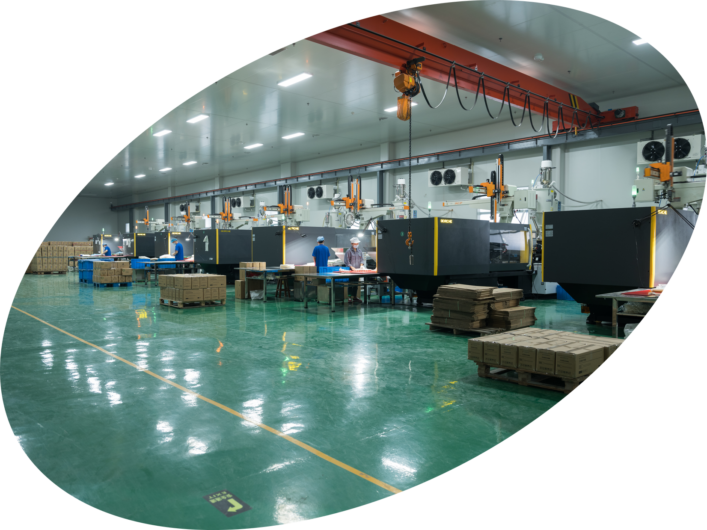
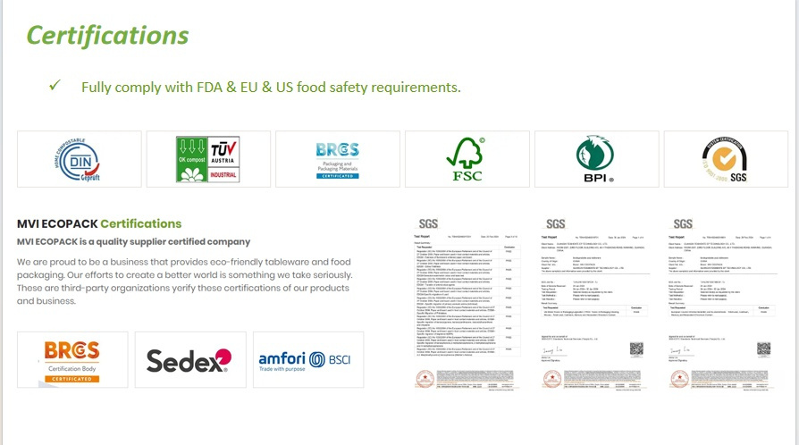
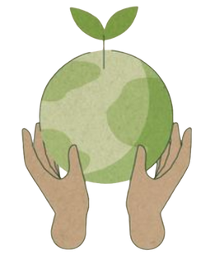
About us
MVI EcoPack was founded in 2010, is a tableware specialist, with offices and factories in mainland China.
We are dedicated to offering our customers good quality and innovations at affordable prices. Our products are made from annually renewable resources like sugarcane pulp, and wheat straw fiber, some of which are by-products of the agriculture industry.
We use these materials to make sustainable alternatives to plastics and Styrofoam. We constantly monitor trends and seek out new products suitable for all clients in countries worldwide.
www.mviecopack.com

Slide 4
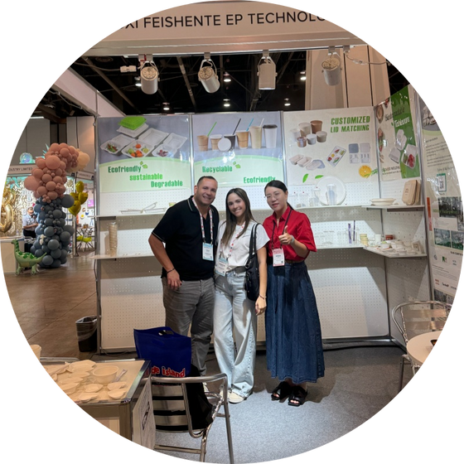
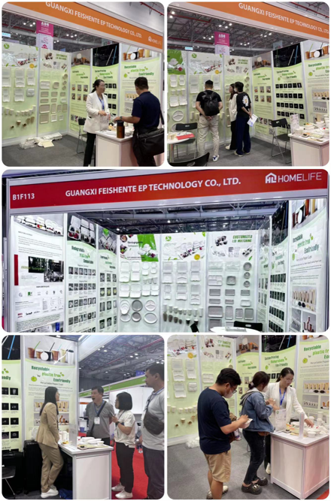
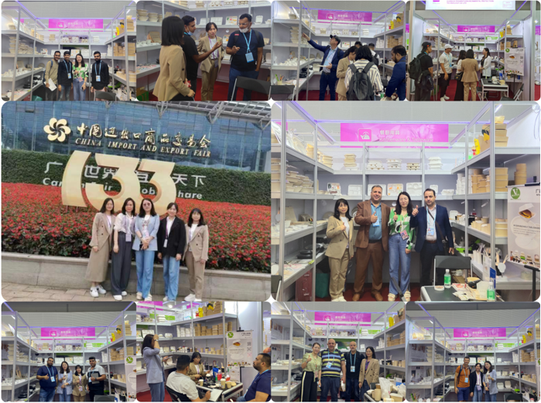
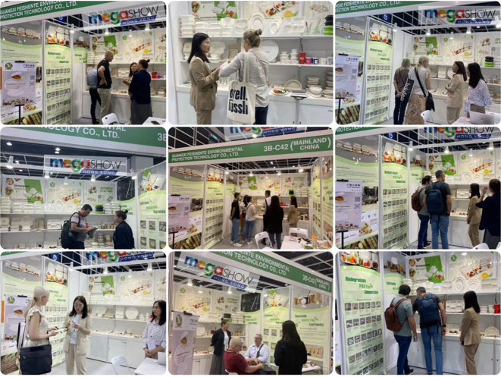
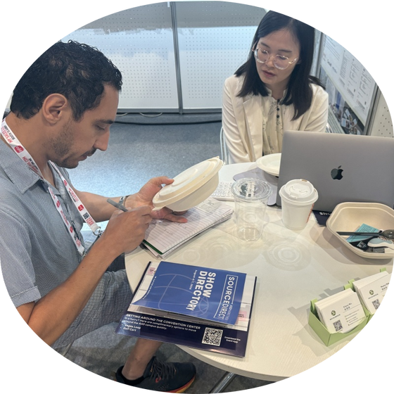
Exhibitions
Discover Excellence: Your Trusted Supplier at the Canton Fair!
www.mviecopack.com

Slide 5
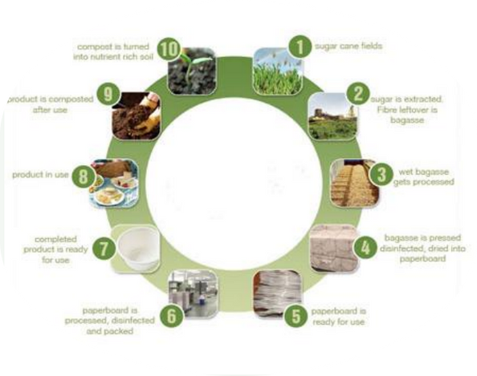

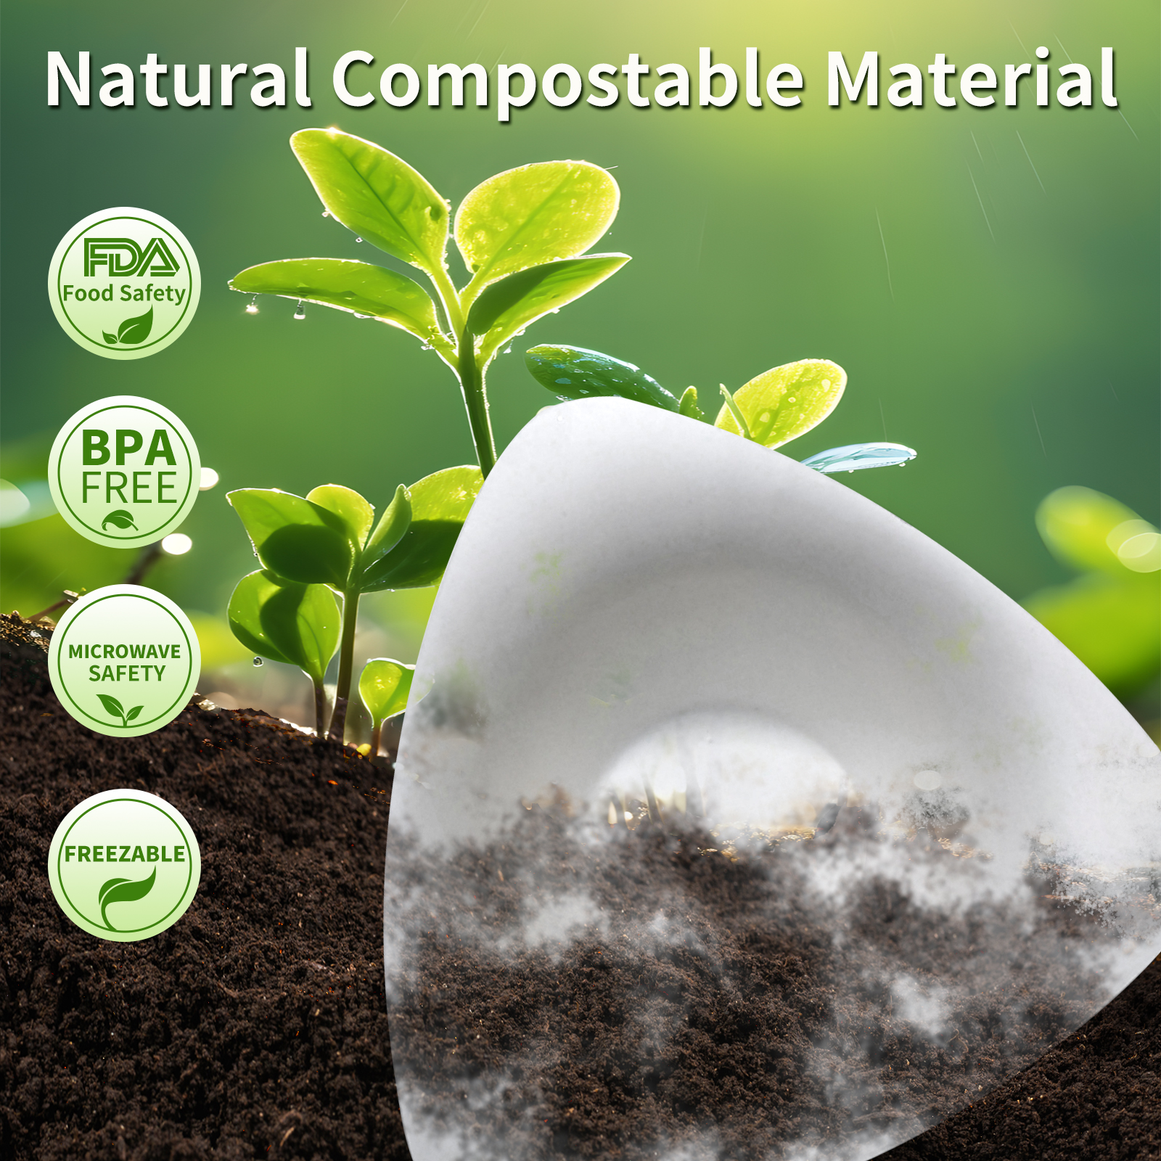


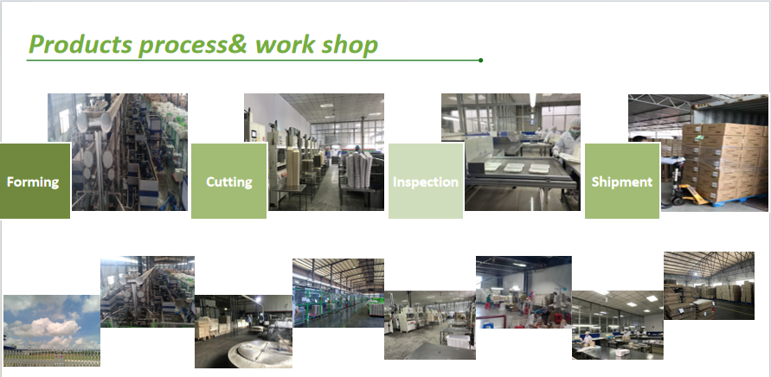
Sugarcane pulp Tableware
WHY WE LOVE BAGASSE ?
Bagasse has a lower carbon foot print
Bagasse is made from sugarcane waste.During the growth of the sugarcane,atmospheric carbon is
captured by the plant and converted to biomass.
Bagasse is recyclable with cardboard
Sugarcane packaging is suitable for recycling along with cardboard (as long as its clean and no food
residue remains).
Sugarcane is a rapidly renewable and widely available resource
In 2017, about 1.8 billion tonnes of sugarcane was harvested world wide.While 30% of the crop yields
sugar products, accounting for 95% of the revenue,the other two-thirds left after harvest has little
economic value and is largely treated as waste.Utilising bagasse for packaging further maxim is the
value of the crop and aligns with the principles of a circular economy.(source)
www.mviecopack.com

Slide 6
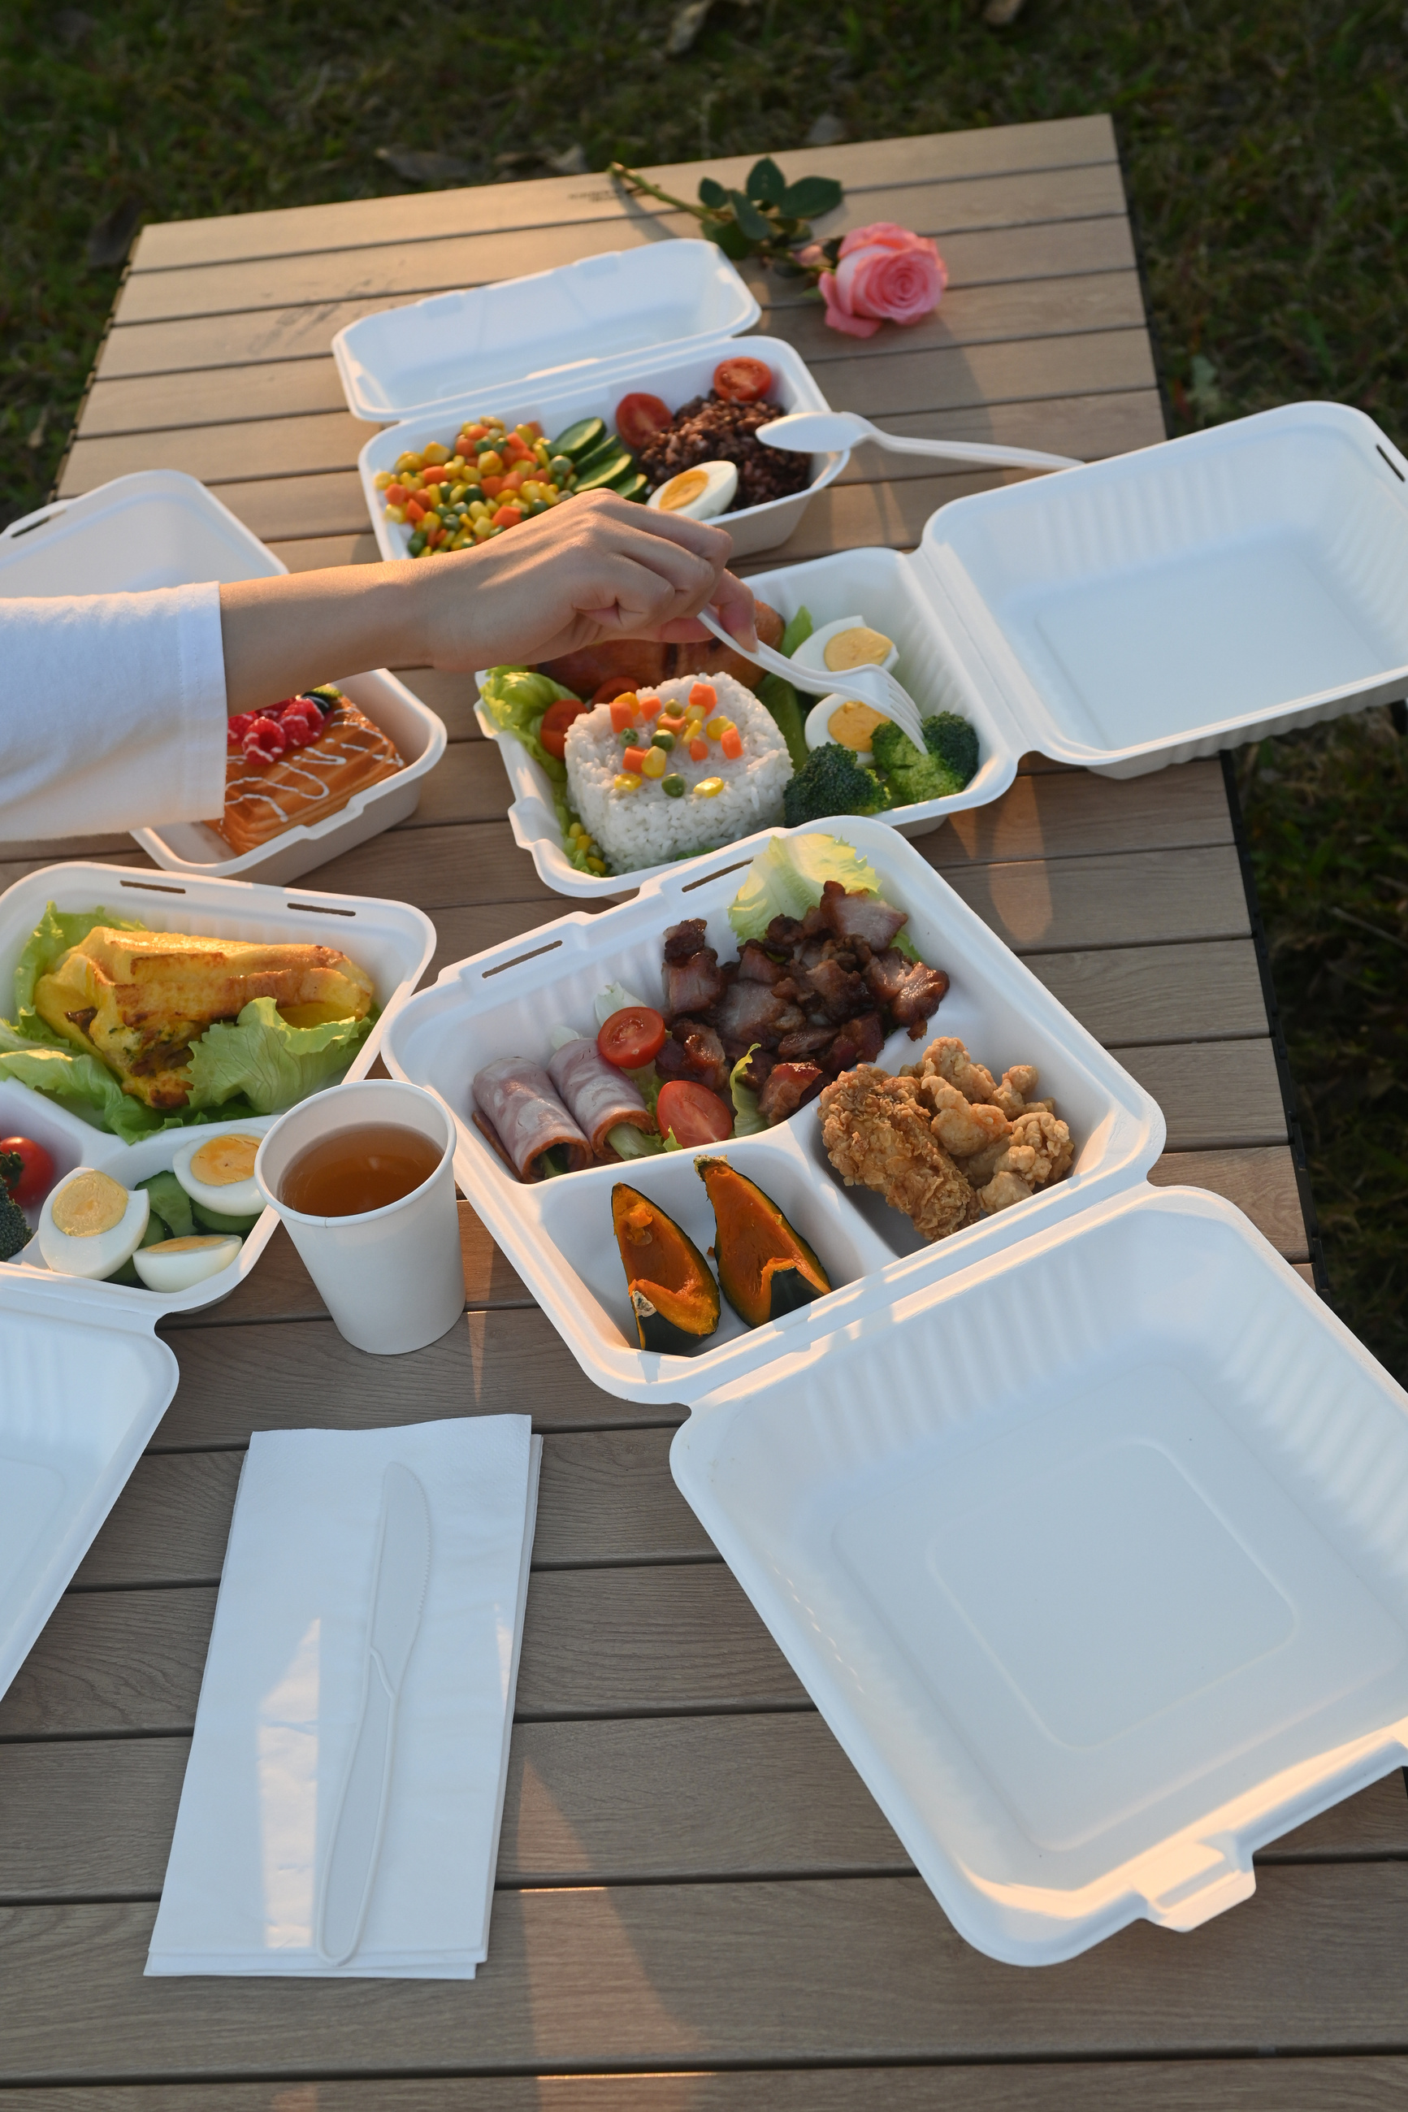
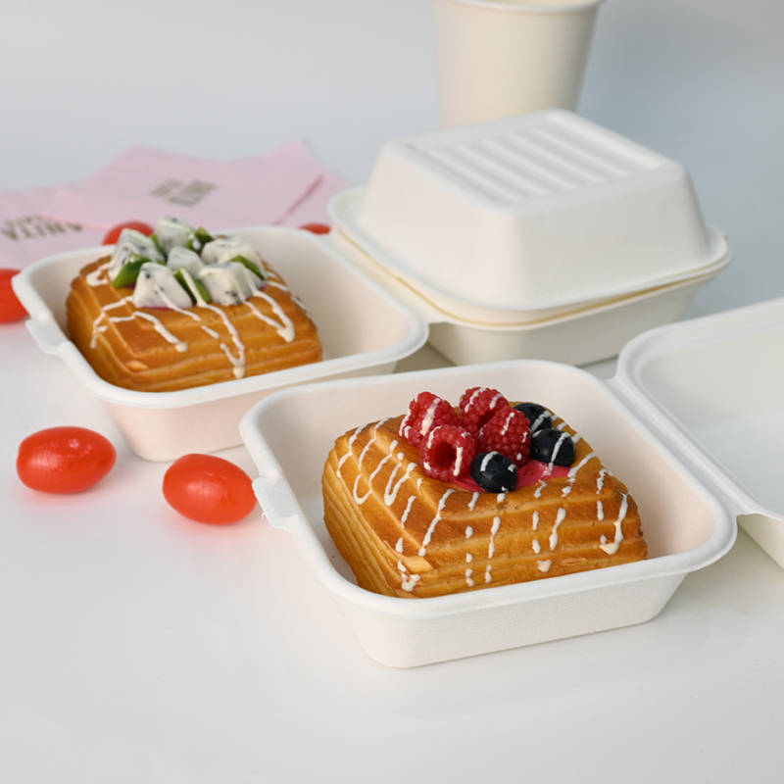
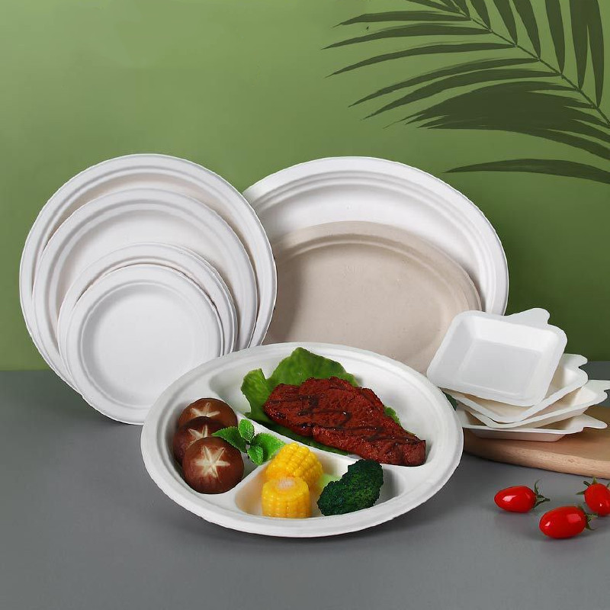
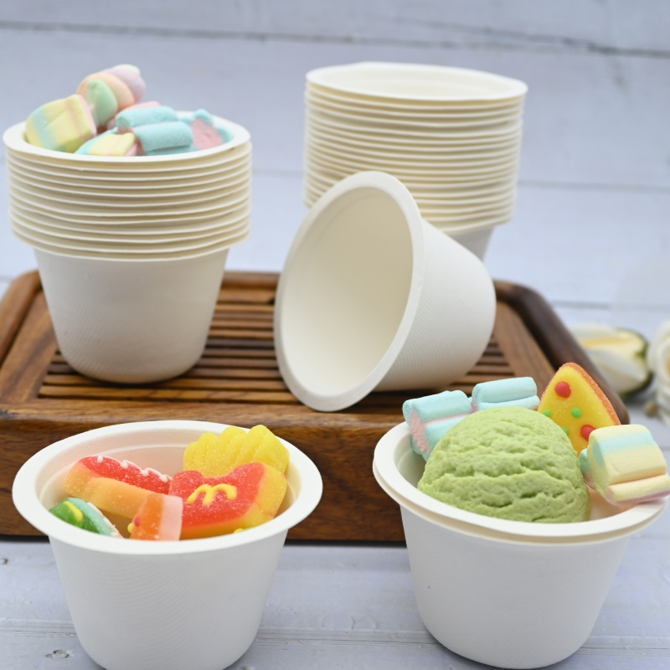
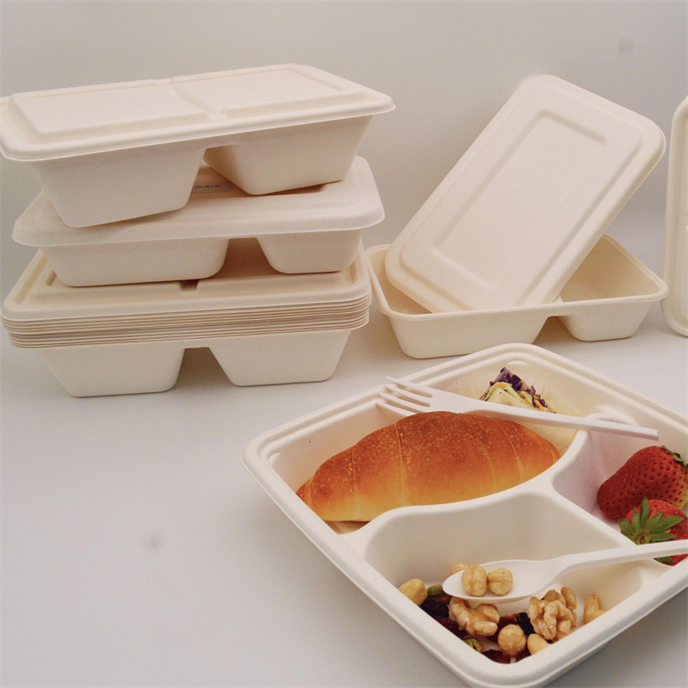
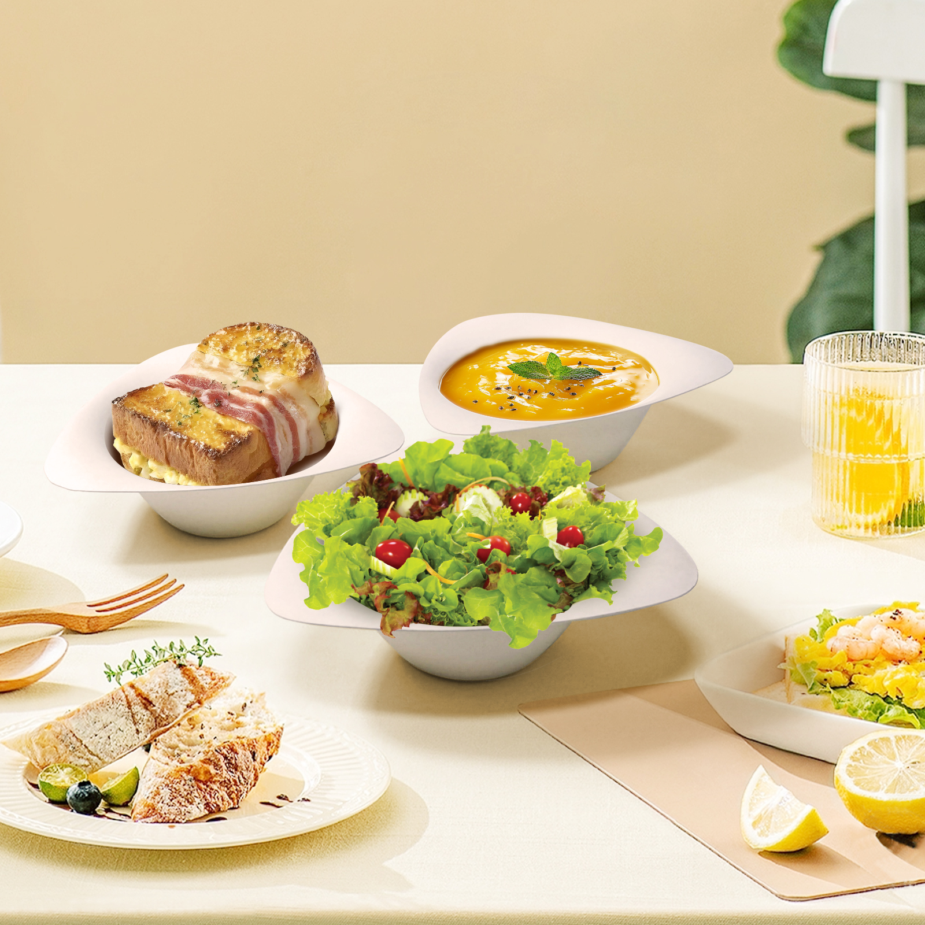
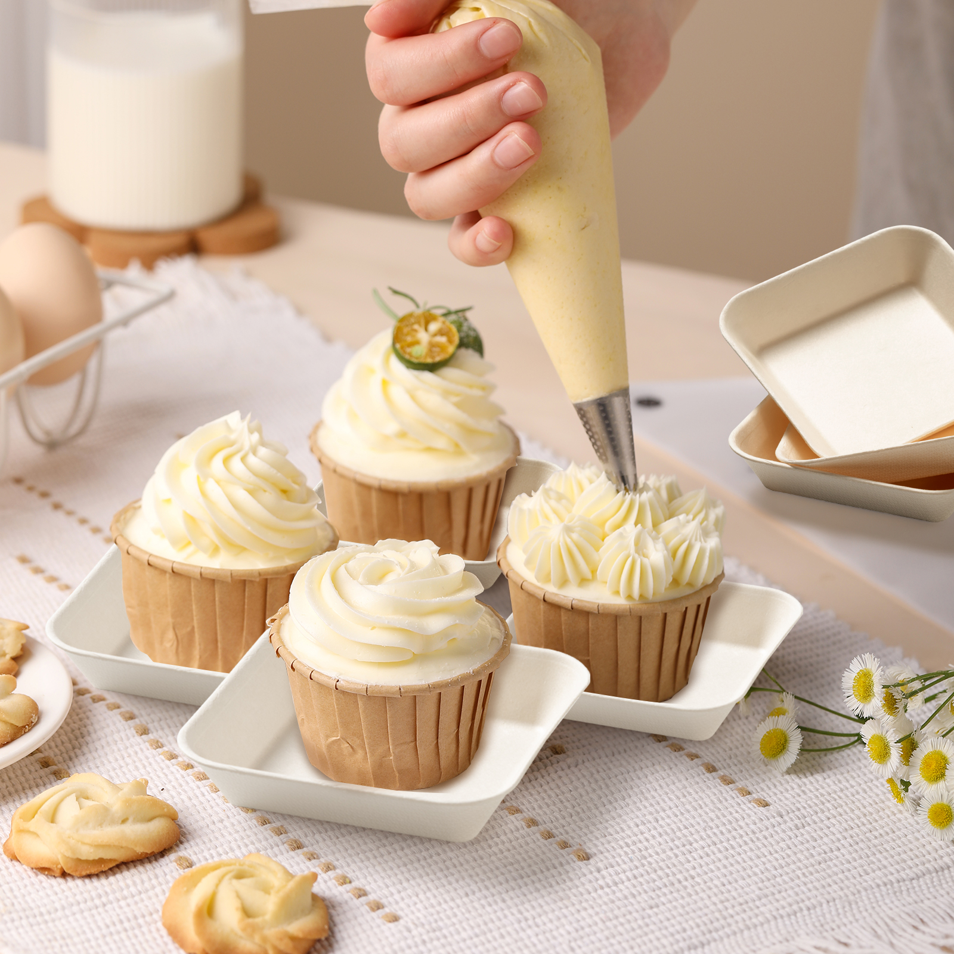
Product List
sugarcane clamshells
sugarcane plates
sugarcane cups
sugarcane trays
sugarcane bowls
Sugarcane mini sauce dishes
www.mviecopack.com

Slide 7
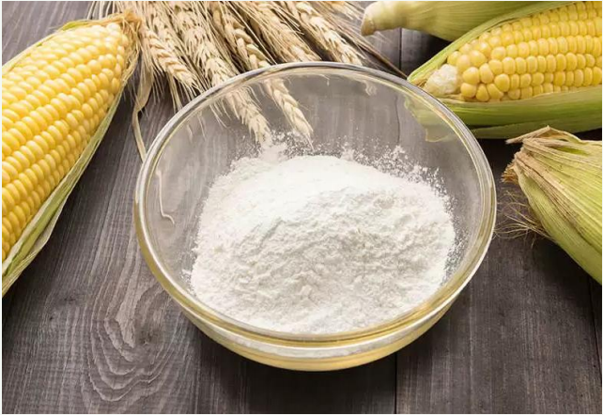
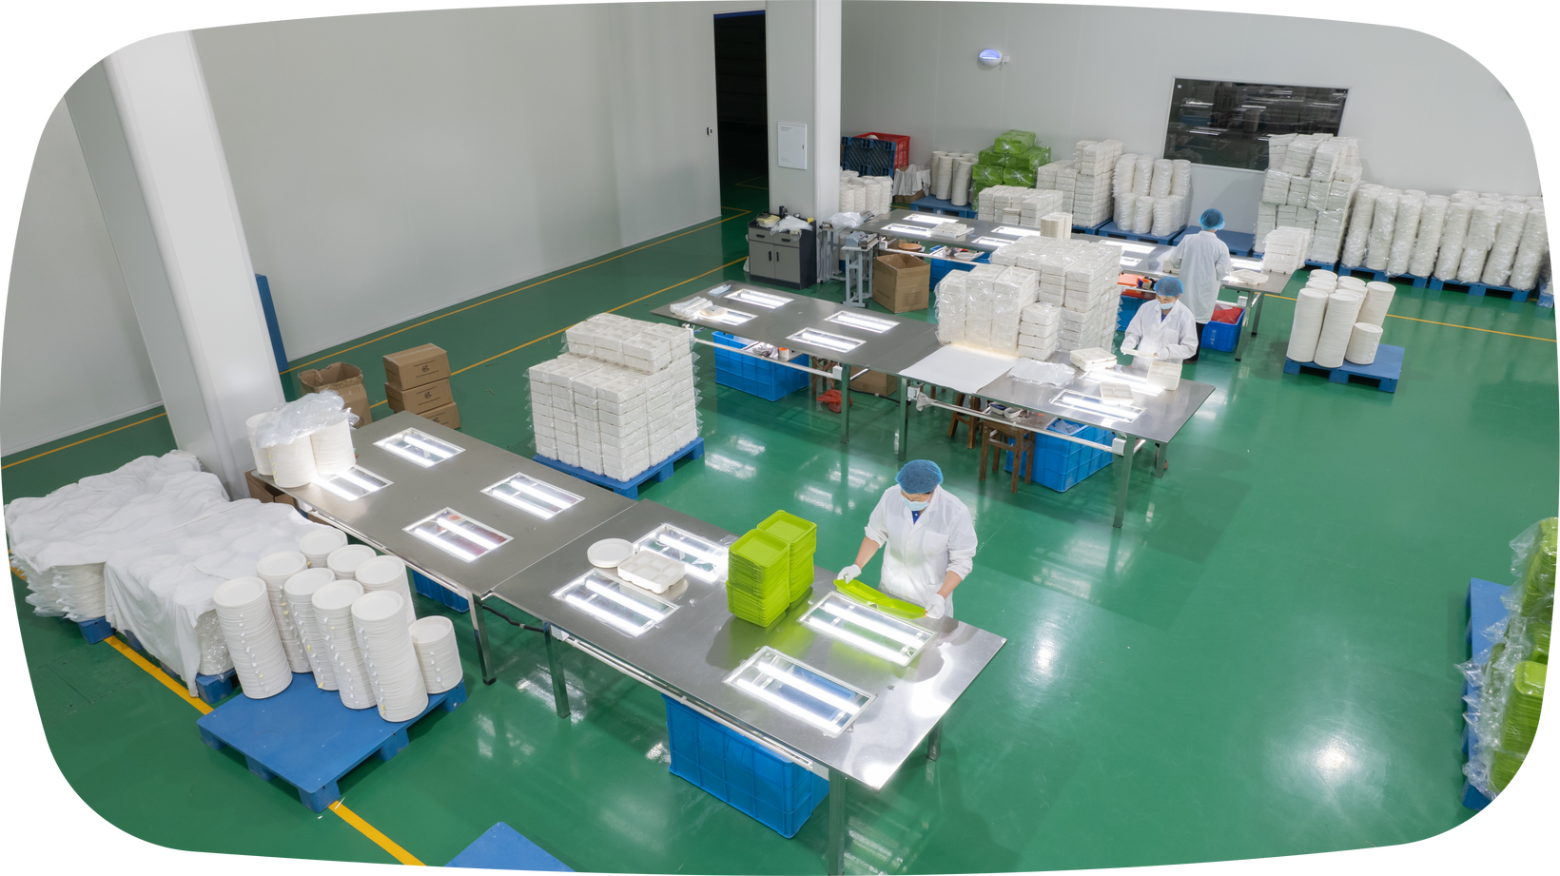
Cornstarch Tableware
Why is cornstarch pulp so popular?
🌍 Cornstarch has a lower carbon footprint
Cornstarch is made from natural corn extracts. During the growth of corn, atmospheric carbon is captured by the plant and converted into biomass. As a result, using cornstarch-based containers helps reduce carbon emissions, aligning with eco-friendly principles.
♻ Cornstarch is biodegradable
Cornstarch containers are biodegradable and can naturally break down under proper conditions into water, carbon dioxide, and biomass. This makes cornstarch containers a sustainable, eco-friendly choice.
🌾 Why should you switch to cornstarch packaging?
Firstly, by switching to the universal cornstarch PLA, MVI ECOPACK is a socially responsible and eco-friendly company where you can customize any eco-friendly tableware type, there by enhancing your brand. As a result, you can expect your overall marketing capabilities to improve as you will be able to effectively attract environmentally conscious customers. Likewise, you can gain greater relevance in the industry as you are able to successfully keep up with the latest packaging trends related to sustainability.
www.mviecopack.com

Slide 8
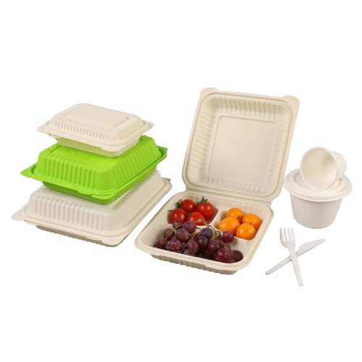
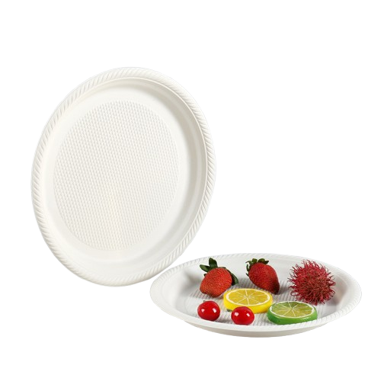
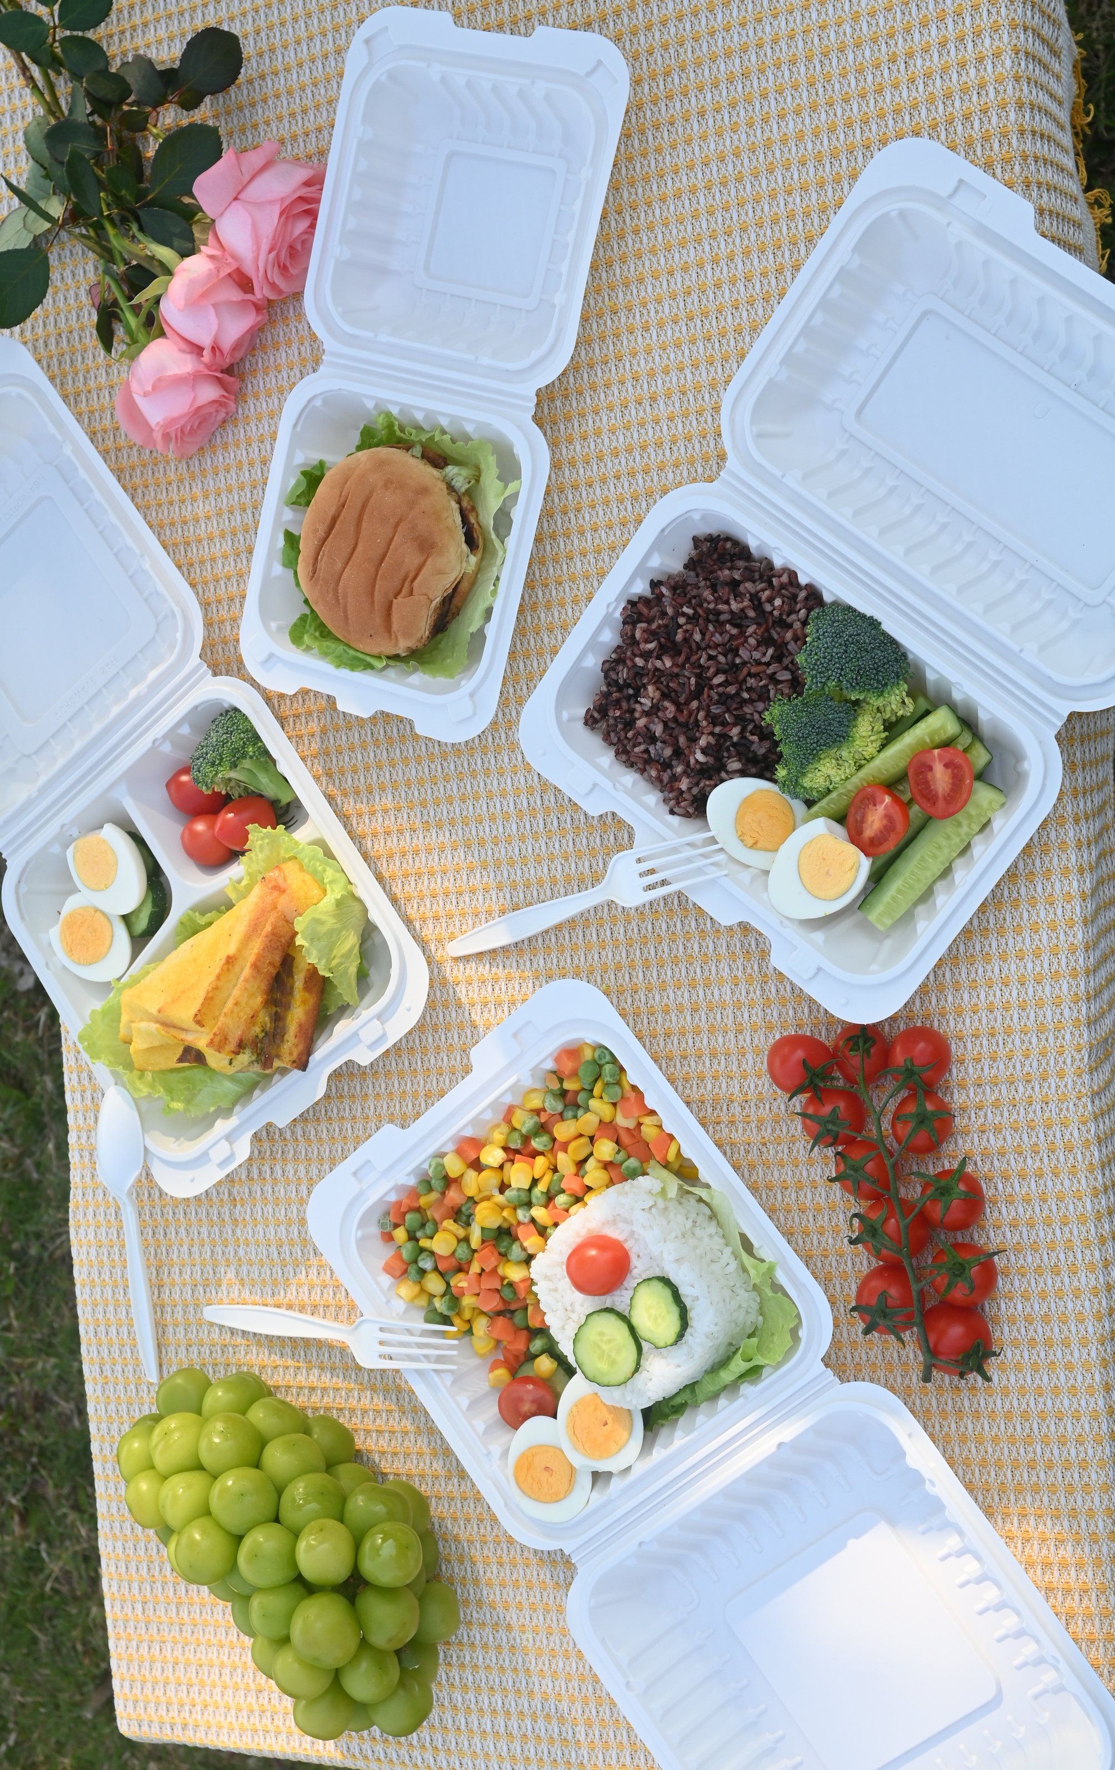
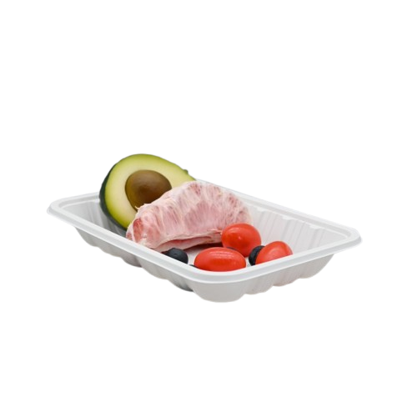
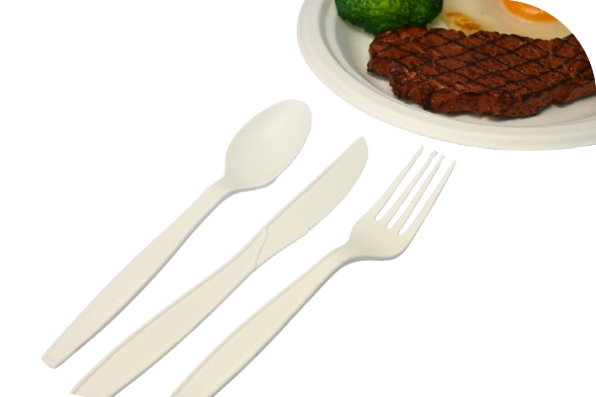
Products List
cornstarch containers
cornstarch plates
cornstarch cutlery
cornstarch trays
www.mviecopack.com

Slide 9
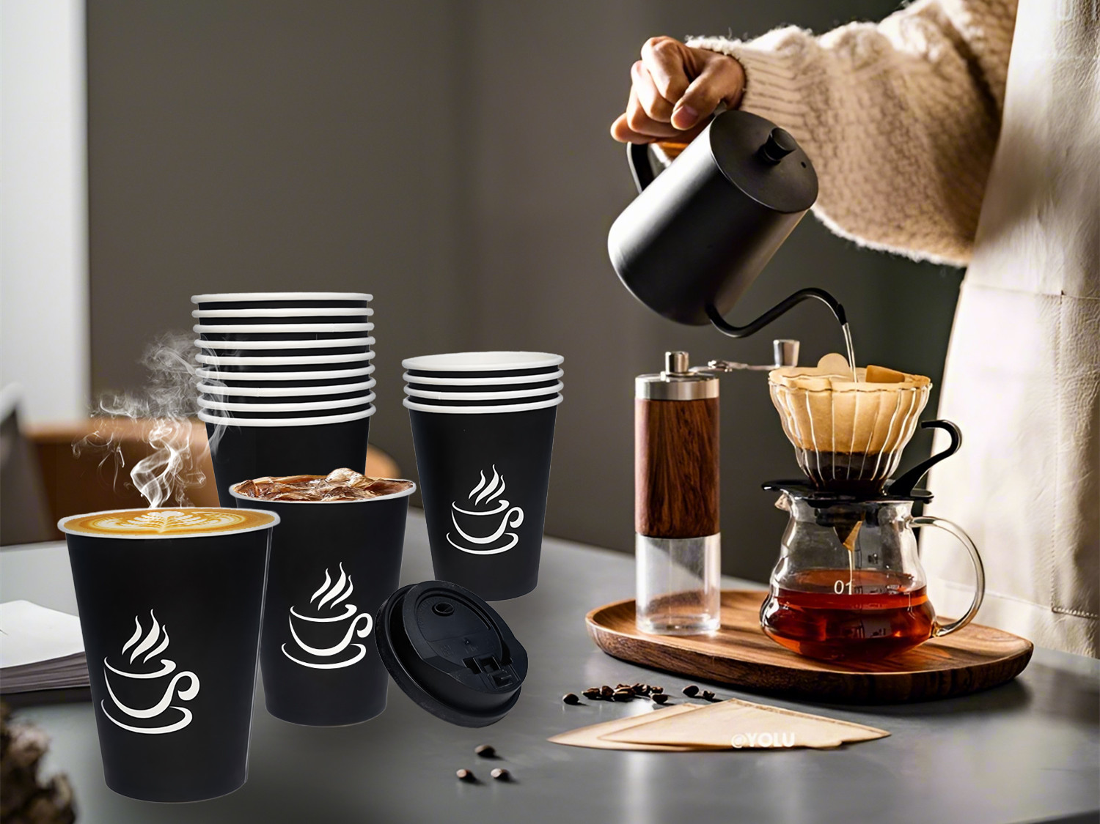
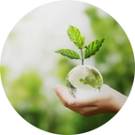
Recyclable paper cups
(Custom your logo)
www.mviecopack.com

Slide 10
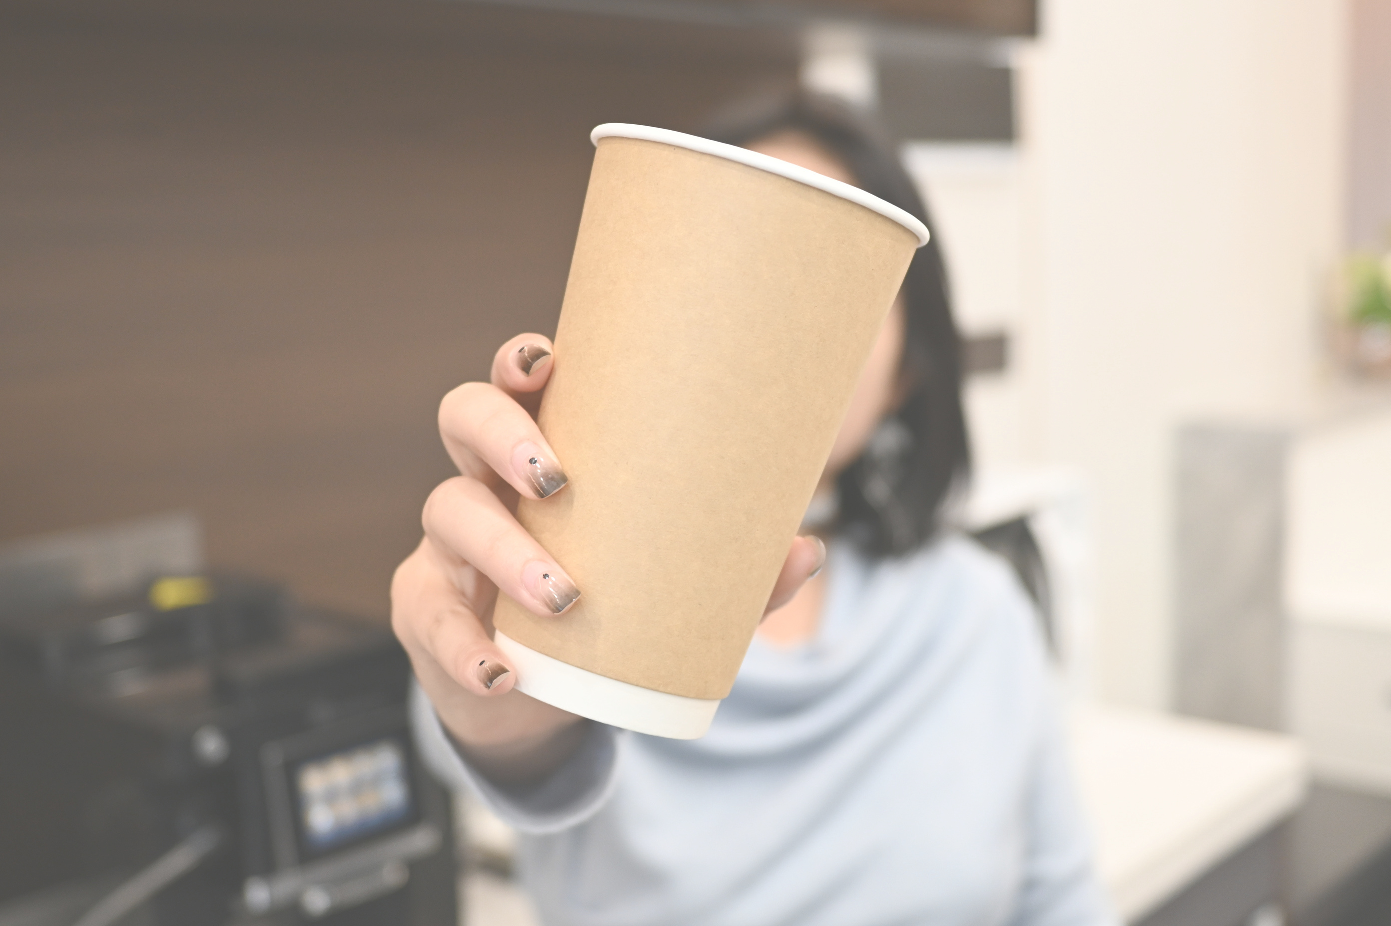
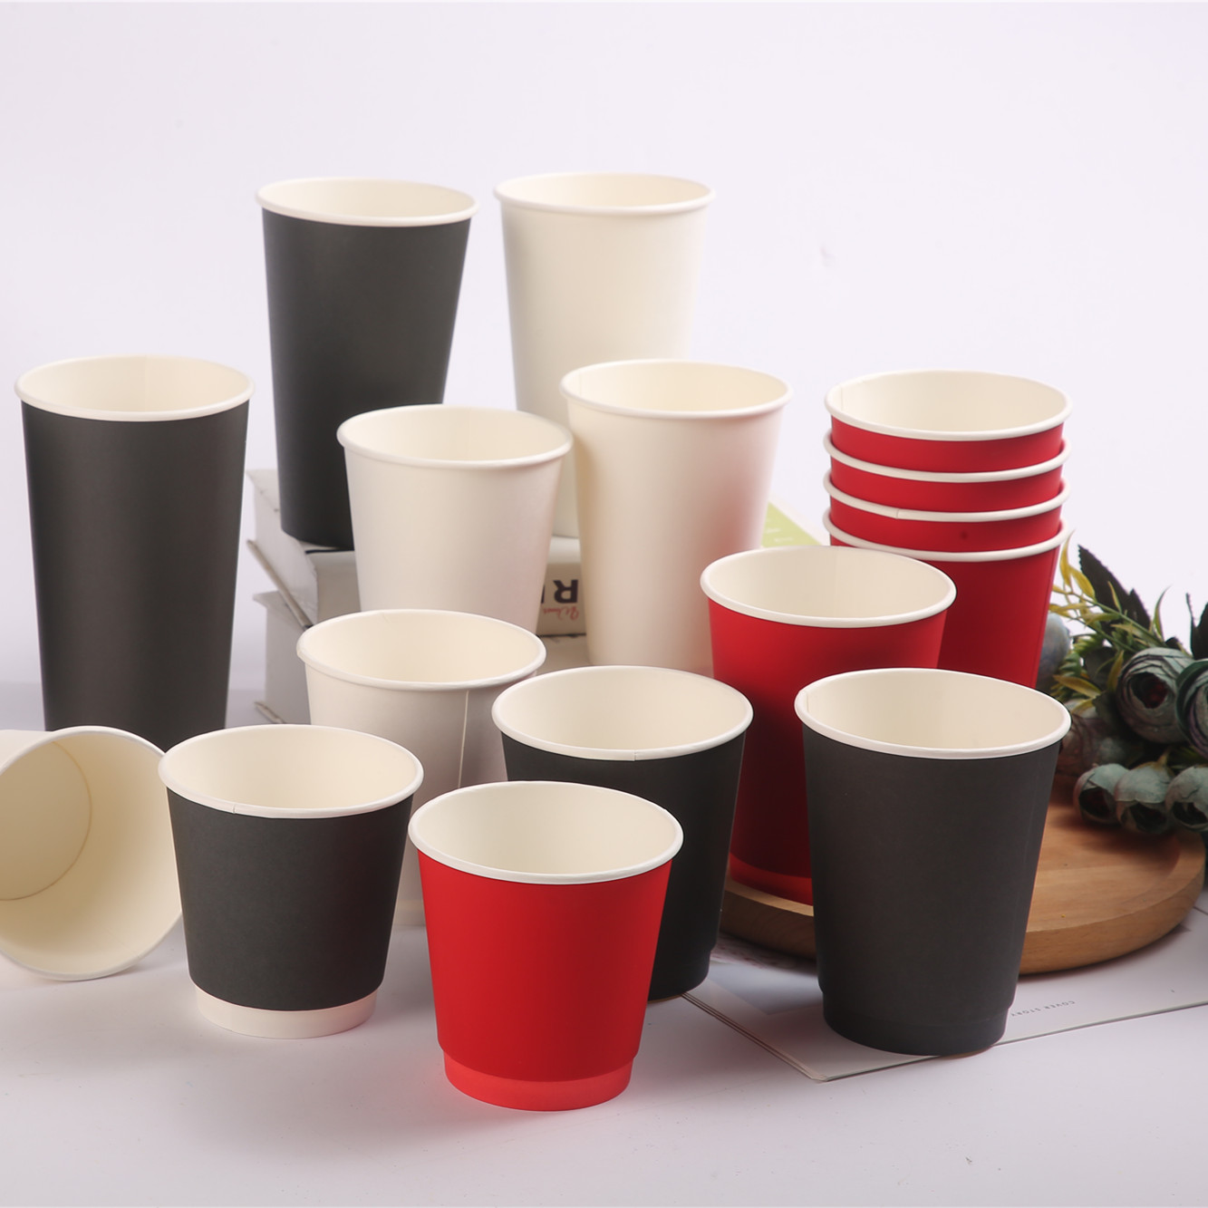
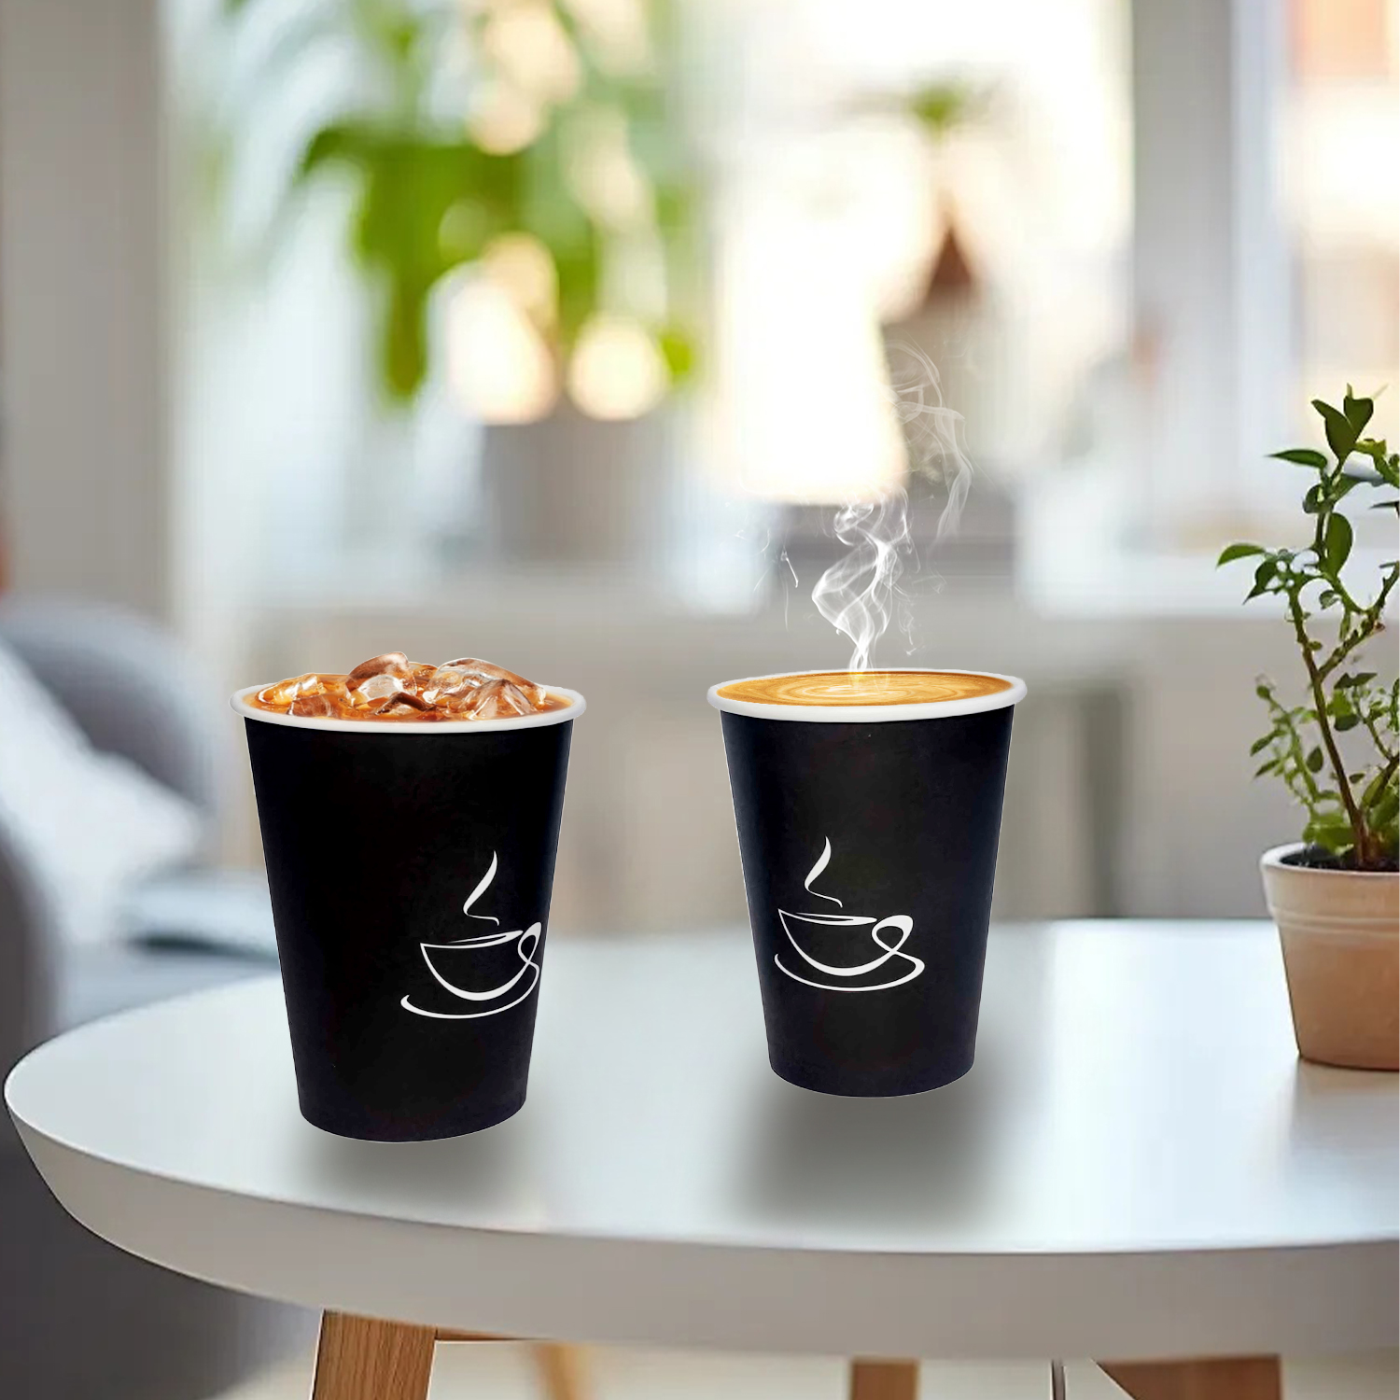
Recyclable paper cups
Name(Bamboo\White\Kraft )
Model No.
Weight (g)
TΦ*BΦ*H(mm)
Pcs / Case Pack
Case Dimensions (cm)
single wall paper cup
4OZ
3.16g
62*45*62
50/2000
51*32*35
single wall paper cup
8OZ
7.8g
80*56*92
50/1000
41*33*38.5
single wall paper cup
12OZ
9.8g
90*60*112
50/1000
45.5*37*48
single wall paper cup
16OZ
12.5g
90*59*136
50/1000
45.5*37*56
double wall paper cup
8OZ
12.5g
80*56*92
25/500
41*33*49
double wall paper cup
12OZ
17.5g
90*60*112
25/500
45.5*37*47.5
double wall paper cup
16OZ
22g
90*59*136
25/500
45.5*37*58
double wall paper cup
20OZ
24.6g
90*60*161
25/500
46*45.5*66
ripple paper cup
8OZ
12g
90*60*84
25/500
45*37*45
ripple paper cup
12OZ
14.7g
90*60*112
25/500
54*33*41
ripple paper cup
16OZ
19.4g
90*59*136
25/500
56*37*45
ripple paper cup
20OZ
25g
90*60*161
25/500
46*45.5*66
www.mviecopack.com

Slide 11
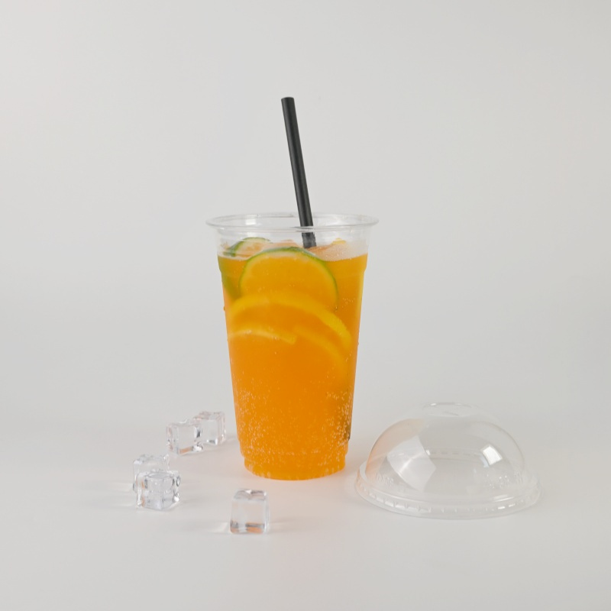
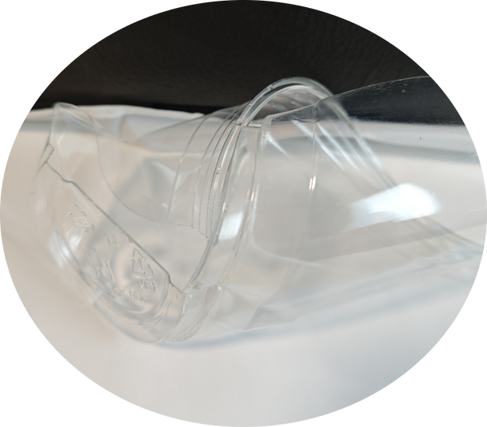
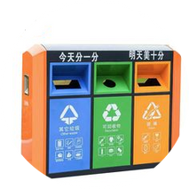
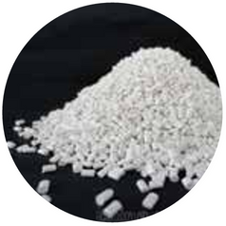

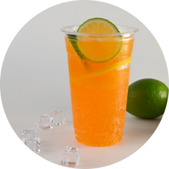
What PET?
PET, full name is Polyethylene Terephthalate ,which extractsfrom oil. It is also regarded as the eco-friendly productsbecause of its non-toxic and scentless. For PET .it is nowrecognized that the best way in the world is to recycle it soas to quantitatively control the entry ofnew products into themarket, This is not only good for the environment, it can alsosave resources.
Temperature range: PET products can withstand a tempera-ture range of -20 °C to 70°C. lt is only used for cold drinking cup.
Transportation & Store: During the transportation or store,PET does not need to add any insulated film.
Recycle : For more convenient recycling, please sort out thegarbage after using up the PET products and throw them intothe designated garbage bin. Whether PET product isenvironmentally friendly depends entirely on wherewe each throw it.
REFINE
RETRIEVE
PROCESS
MANUFACTURE OTHER PRODUCTS
PRODUCT
www.mviecopack.com

Slide 12
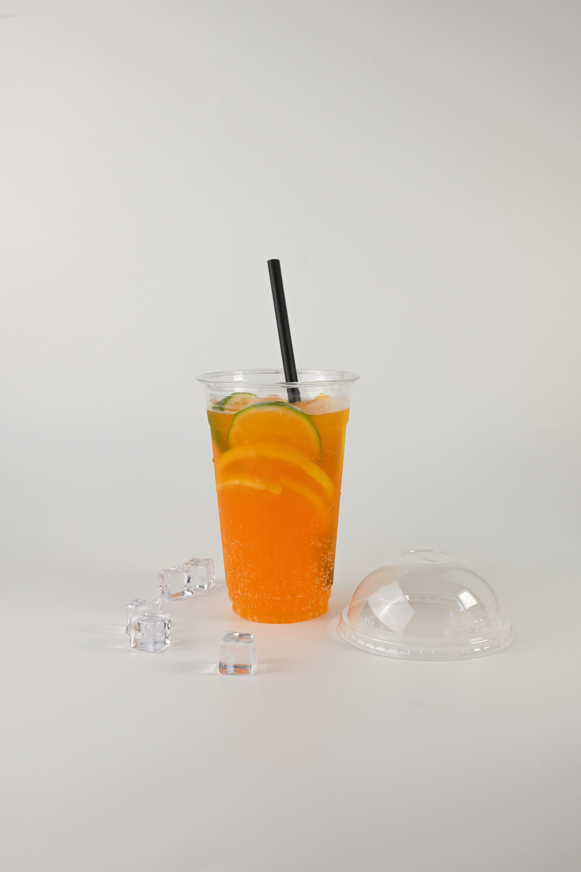
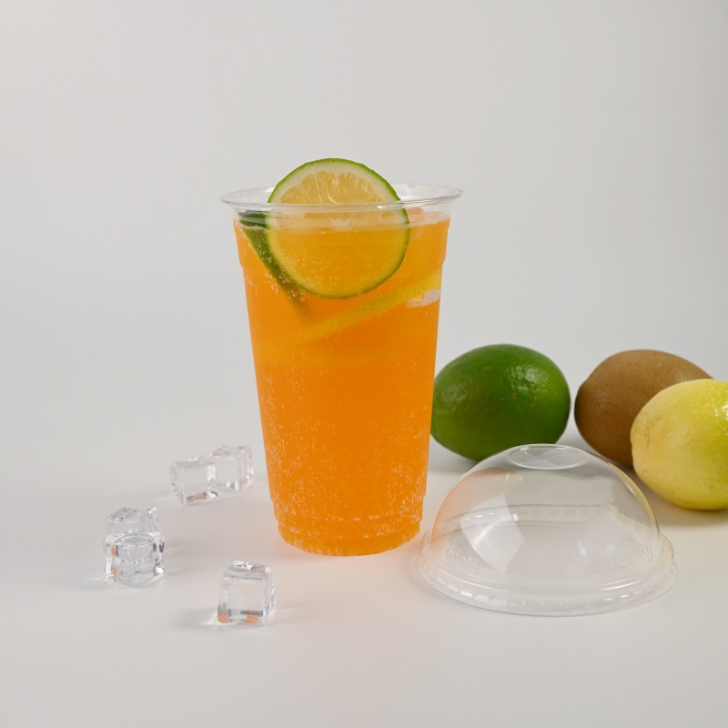
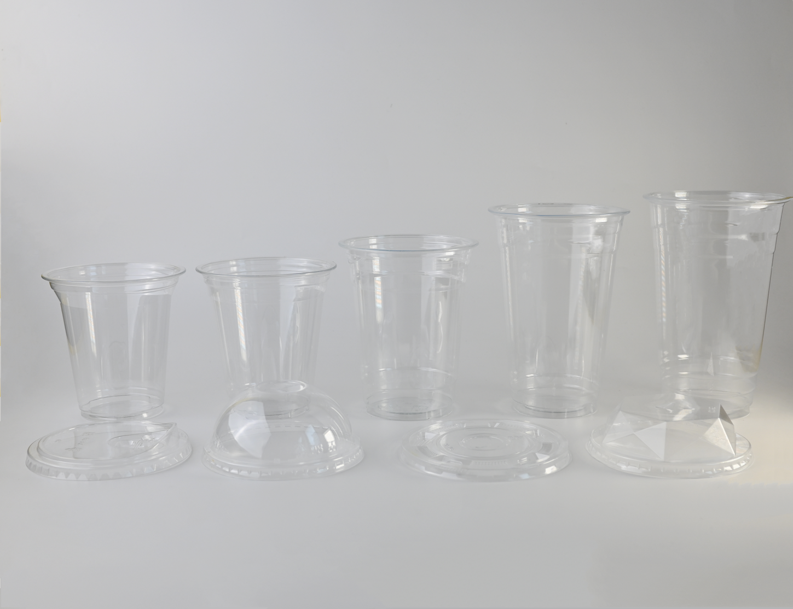
PET Cup
Model No.
Weight (g)
TΦ*BΦ*H(mm)
Pcs / Case Pack
Case Dimensions (cm)
MVI-98-12OZ
12
98/55/107
50/1000
50.5*40.5*41
MVI-98-14OZ
12
98/57/105
50/1000
50.5*40.5*39
MVI-98-16OZ
13.5
98/62/126
50/1000
50.5*40.5*48.5
MVI-98-20OZ
16
98/60/145
50/1000
50.5*40.5*52
MVI-98-24OZ
16.5
98/59/153
50/1000
50.5*40.5*53.5
PET Lid
Model No.
Weight (g)
TΦ*BΦ*H(mm)
Pcs / Case Pack
Case Dimensions (cm)
MVI-FL98-A
2.8
98
50/1000
50*20.5*41.7
MVI-DL98-A
3.8
98
50/1000
50*25*40.5
MVI-FL98-B
3.8
98
50/1000
50.5*27*41
3.8
98
50/1000
50.5*25*41
MVI-DL98-B
MVI-CL98
4
98
50/1000
50.5*25*42.5
www.mviecopack.com

Slide 13
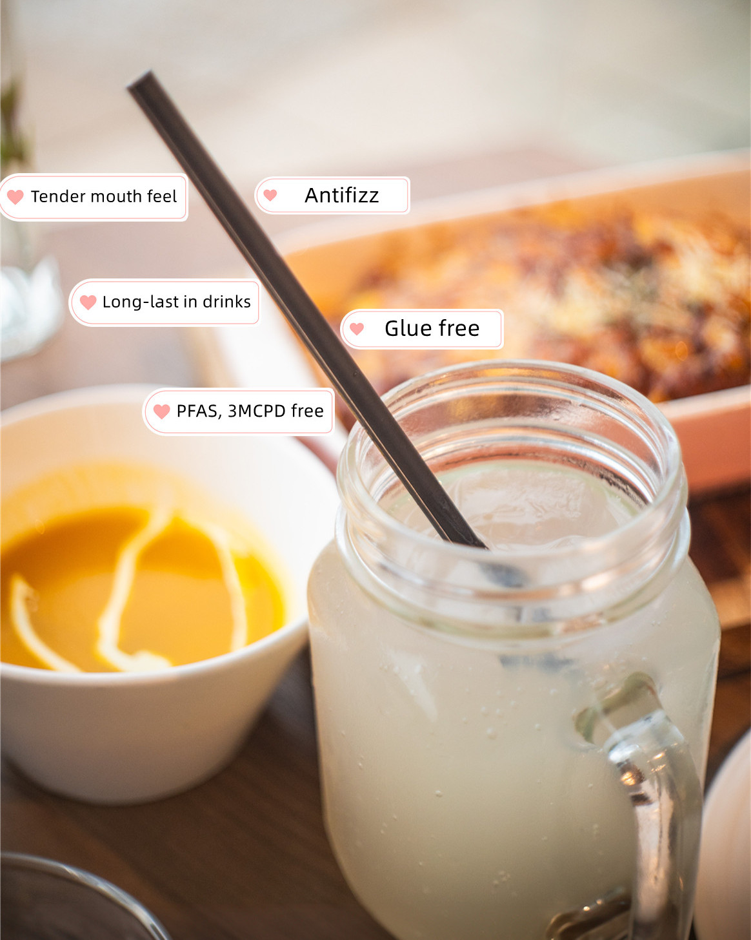
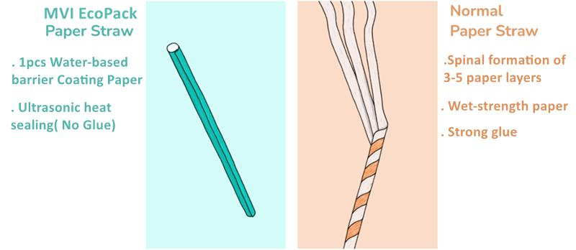

MVI EcoPack Paper Straw Reinvented
Aqueous Coating paper straw by adopting the new technology “Paper+water based coating”
to achieve Strawfully recyclable and re-pulpable.
Aqueous Coating Paper Straw Advantage
No Sogginess
Long Service Time (Durable For More Than 3 Hrs)
Better Mouthfeel (Flexible & Comfortable)
Hot Drinks & Soft Drinks Friendly (No Glue)
Use less paper (20-30% less than common paper straws)
Close the loop & zero waste (while common paper
straws are not recyclable)
www.mviecopack.com

Slide 14
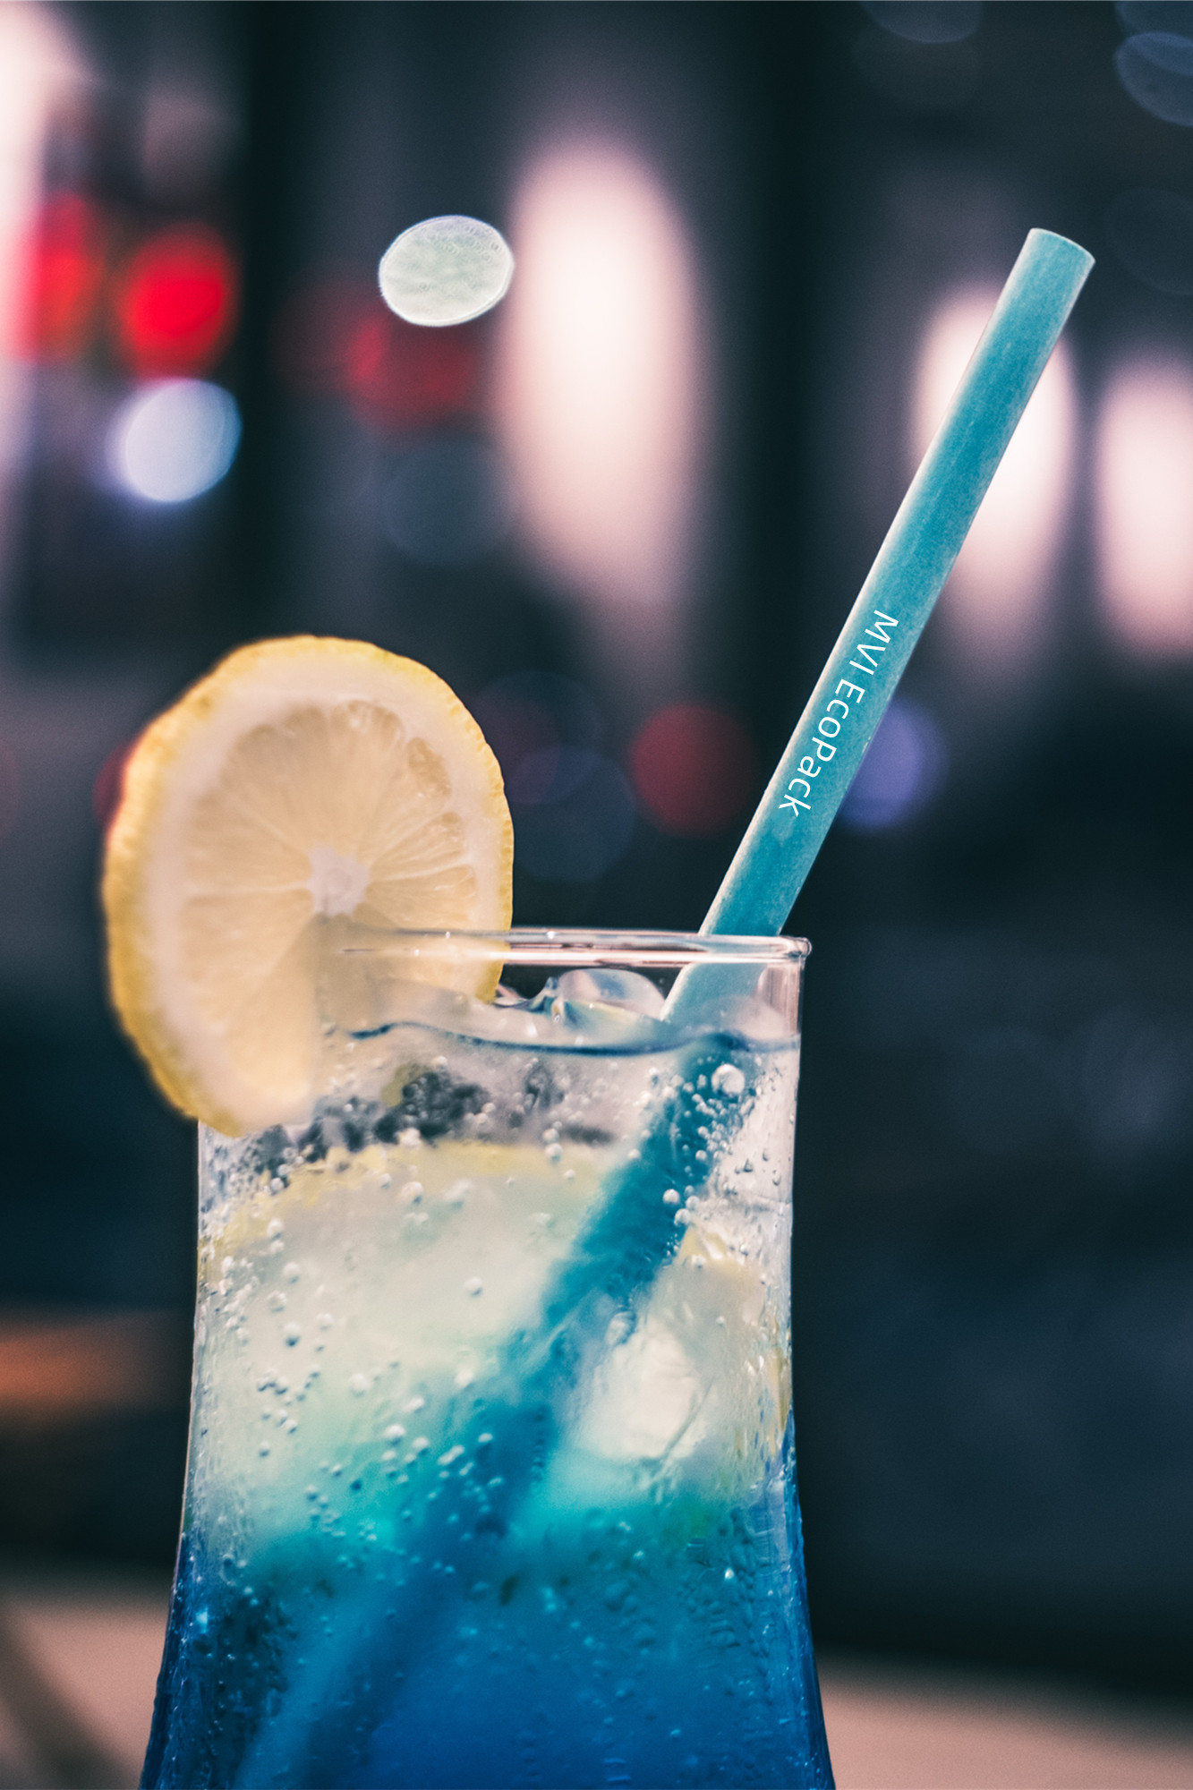
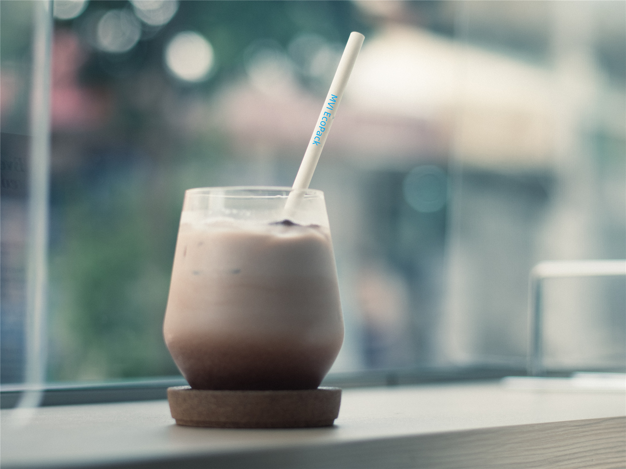
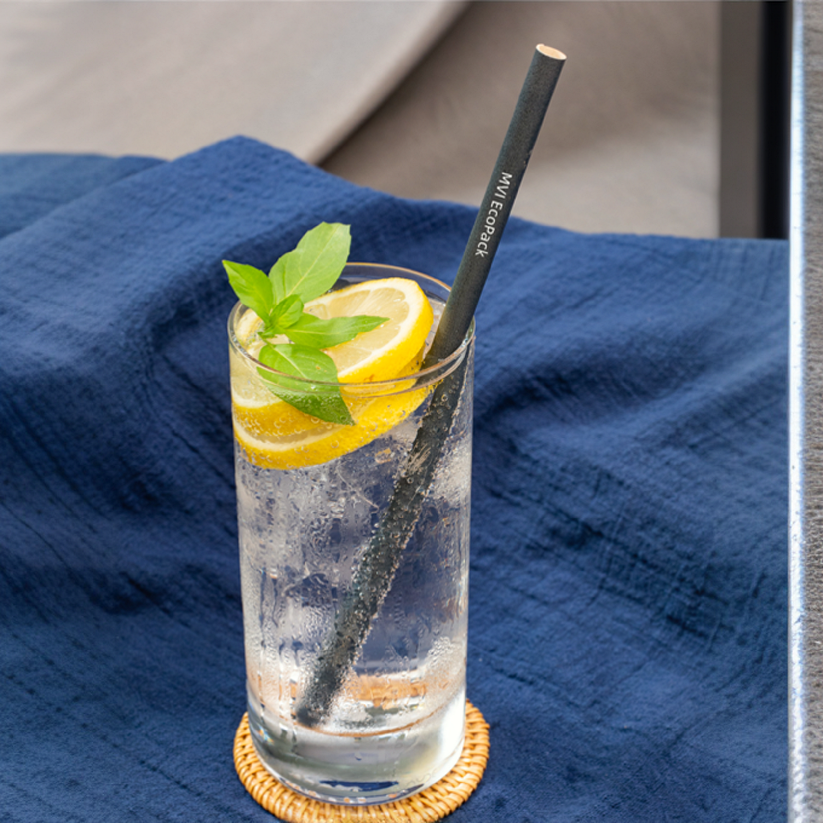
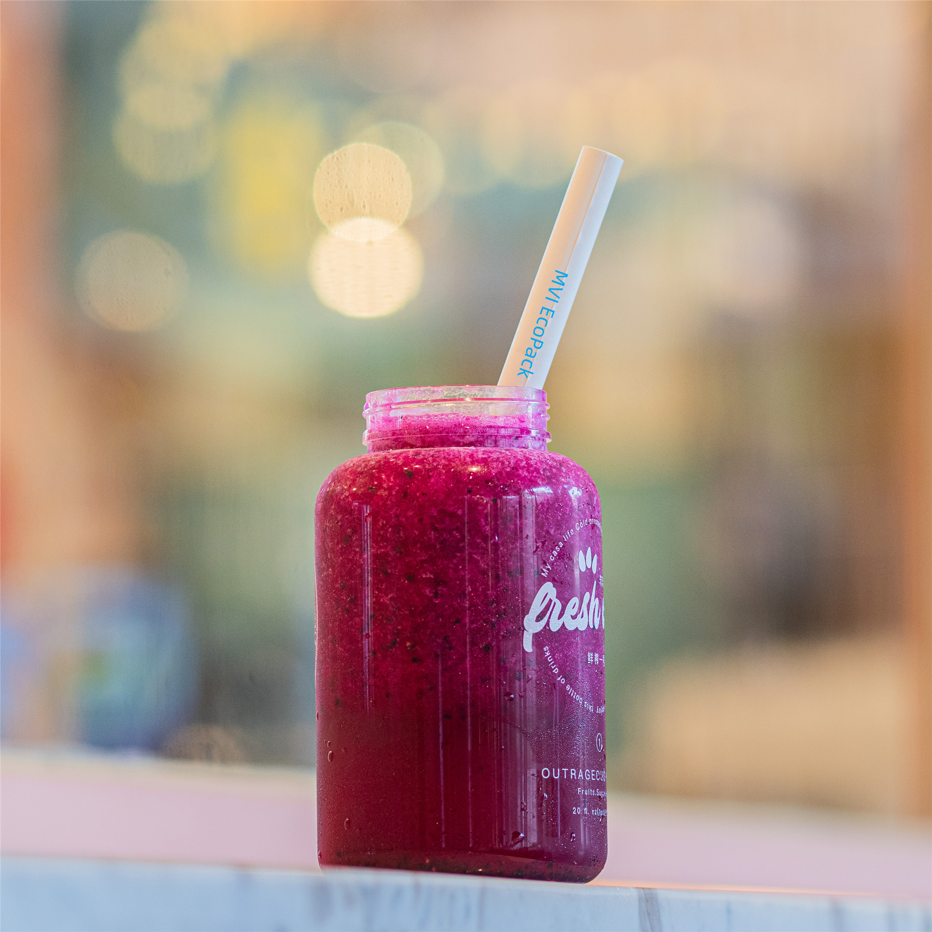
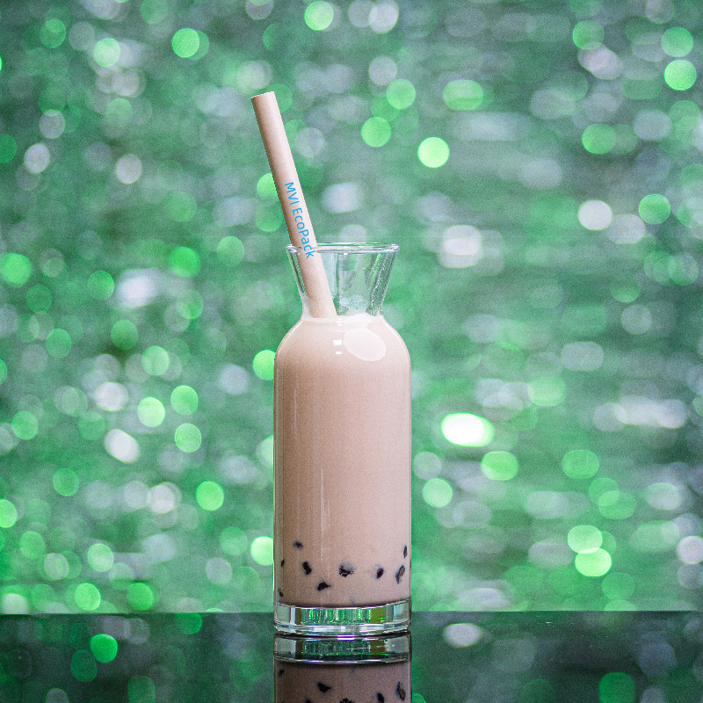
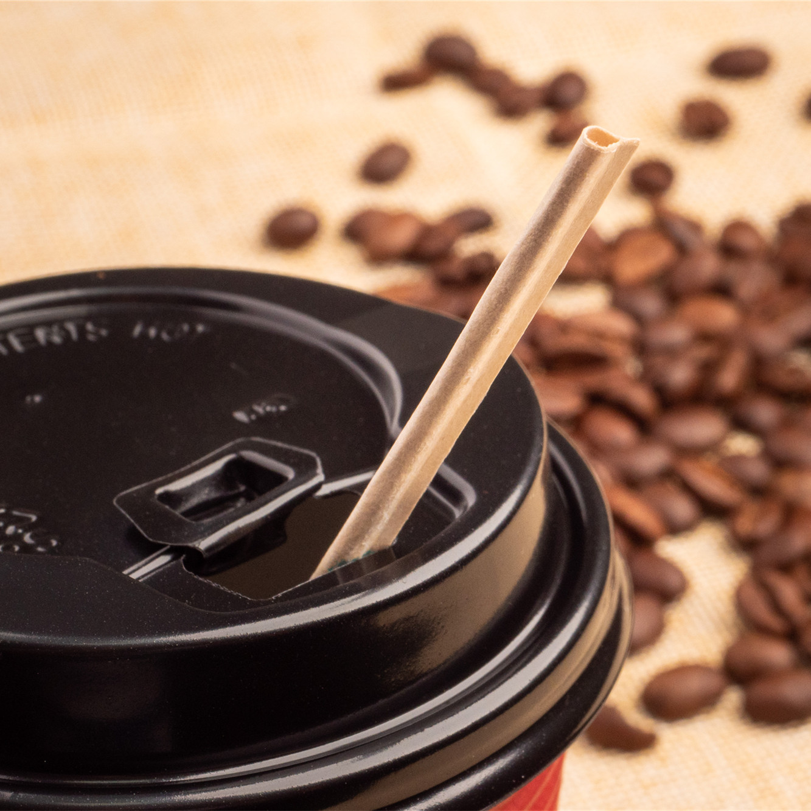

Product List
6mm paper straw
Best for general purpose
Length 130-260mm
8mm paper straw
Best for general purpose smoothie
Length 130-260mm
10mm paper straw
Best for smoothie
Length 190-260mm
12mm paper straw
Best for bubble tea
Length 190-260mm
Paper Stirrer straw
Best for coffee stirrer/ cocktall
Length 140/190mm
Straw tips Options:
Flat/ sharp/ spoon
www.mviecopack.com

Slide 15








Others
paper bowl
bamboo stirring stick
wooden cutlery
kraft paper container
cutlery wrapper
bamboo paper cup
paper napkin
www.mviecopack.com

Slide 16







Contact Us
Guangxi Feishente EP Technology Co., Ltd.
Address: No. 48 Tinghong Road, Jiangnan District,
Nanning City Guangxi,China,530031
Tel:+86 771 3182966
E-mail:orders@mvi-ecopack.com
Website:www.mviecopack.com
www.linkedin.com/company/mvi-ecopack
www.facebook.com/MviEcopack
www.instagram.com/mvi.ecopack
www.mviecopack.com

